Slide 2



Slide 3
2022 is the URC’s Jubilee Year; it will be 50 years old. You are invited to our Jubilee party. Join the fun and find out more about the URC. ^{Let’s share our stories and} ^{celebrate together.}

Slide 4
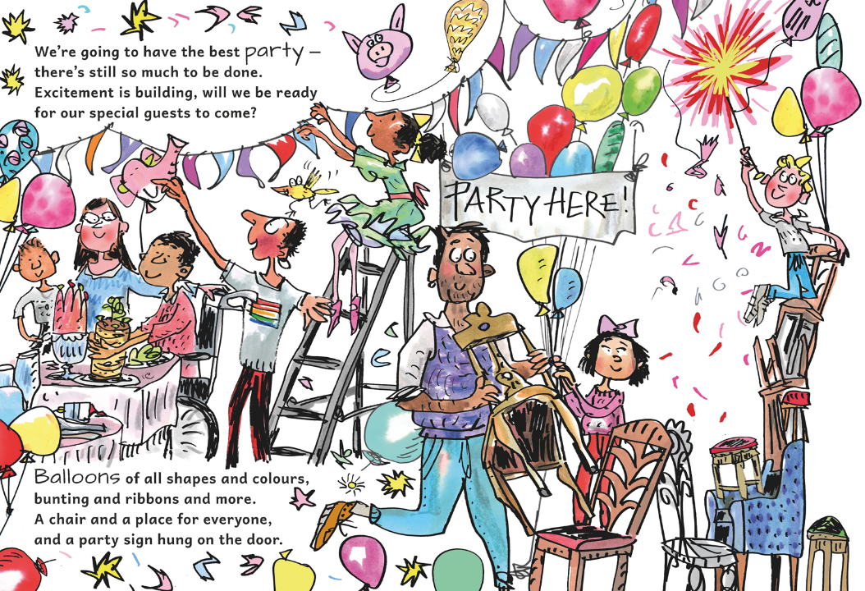

Slide 5
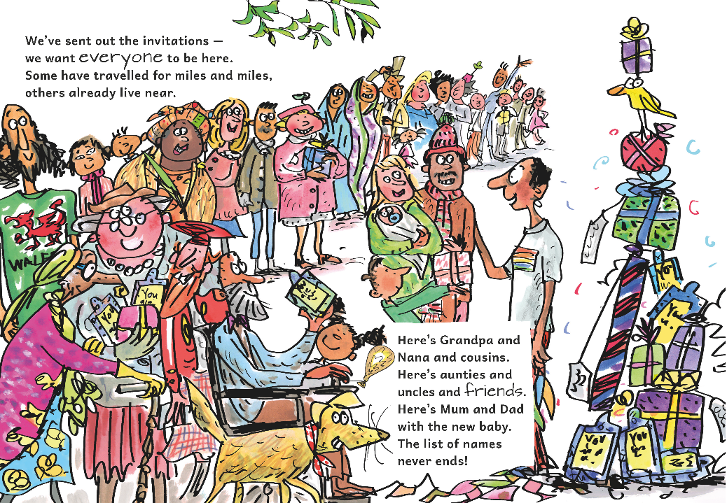

Slide 6
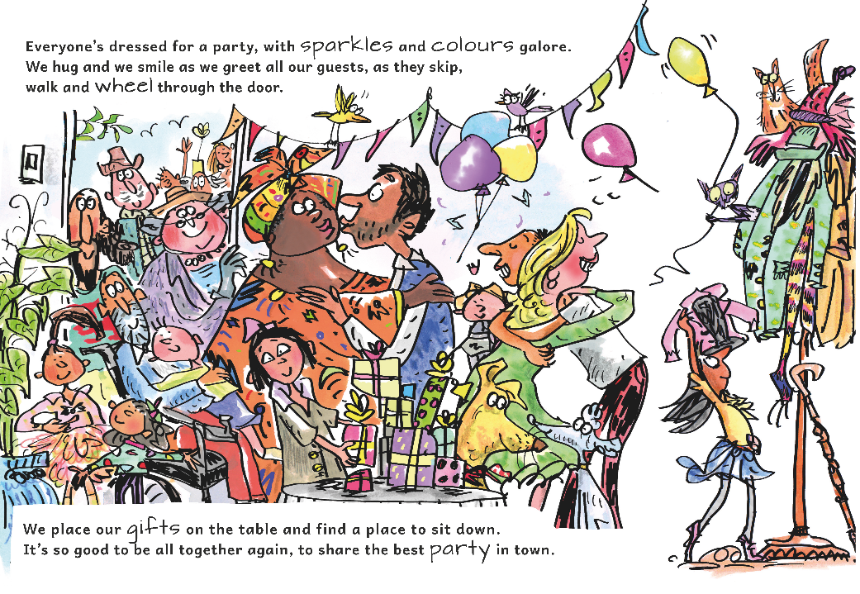

Slide 7
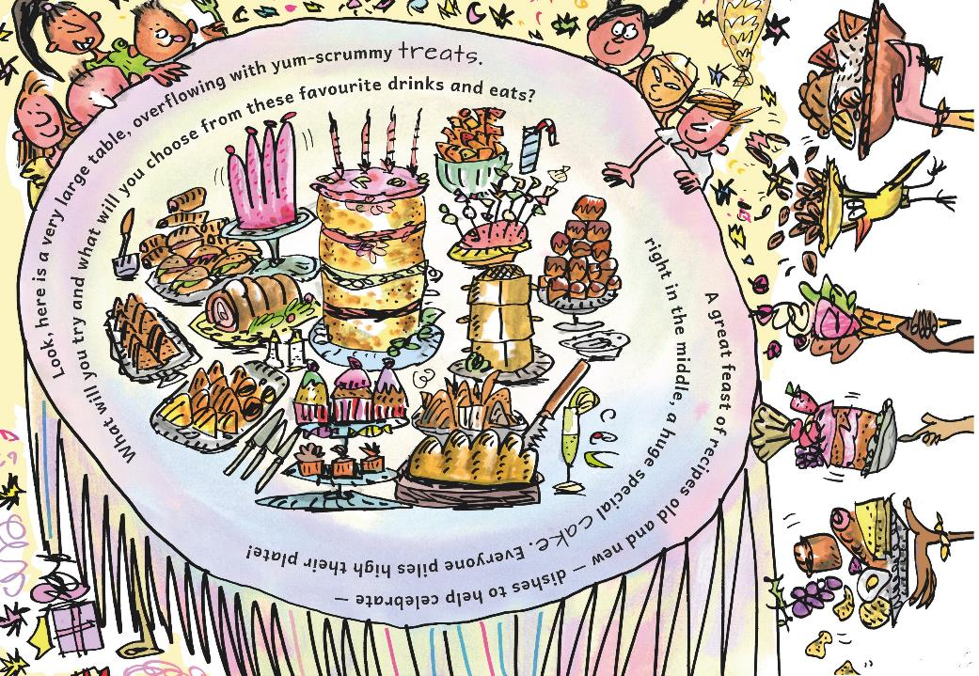

Slide 8
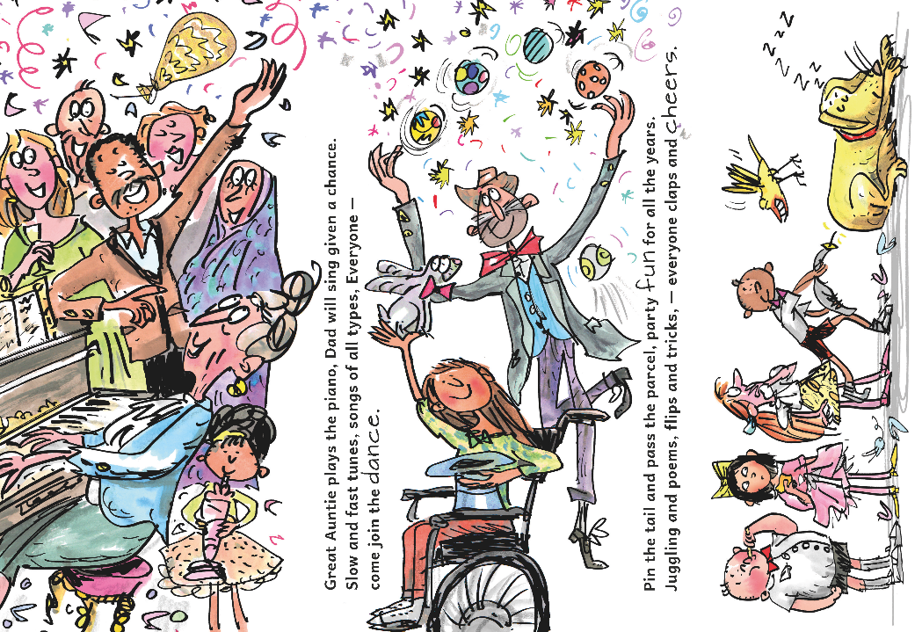

Slide 9
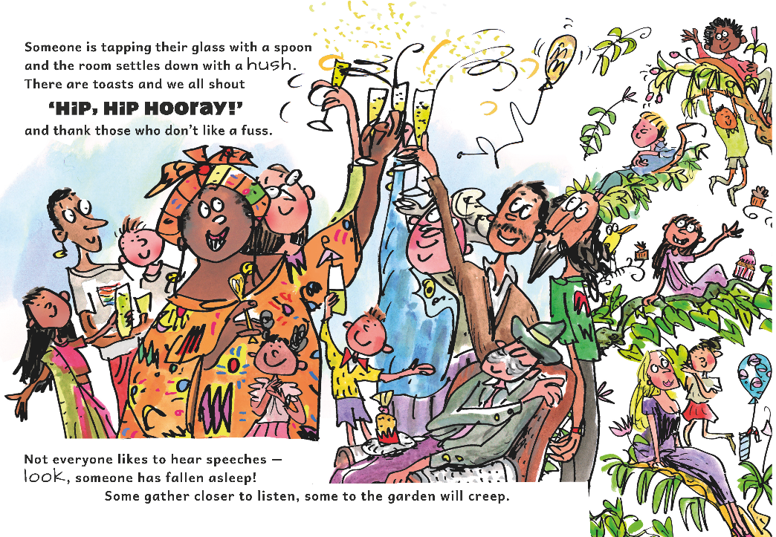

Slide 10


Slide 11
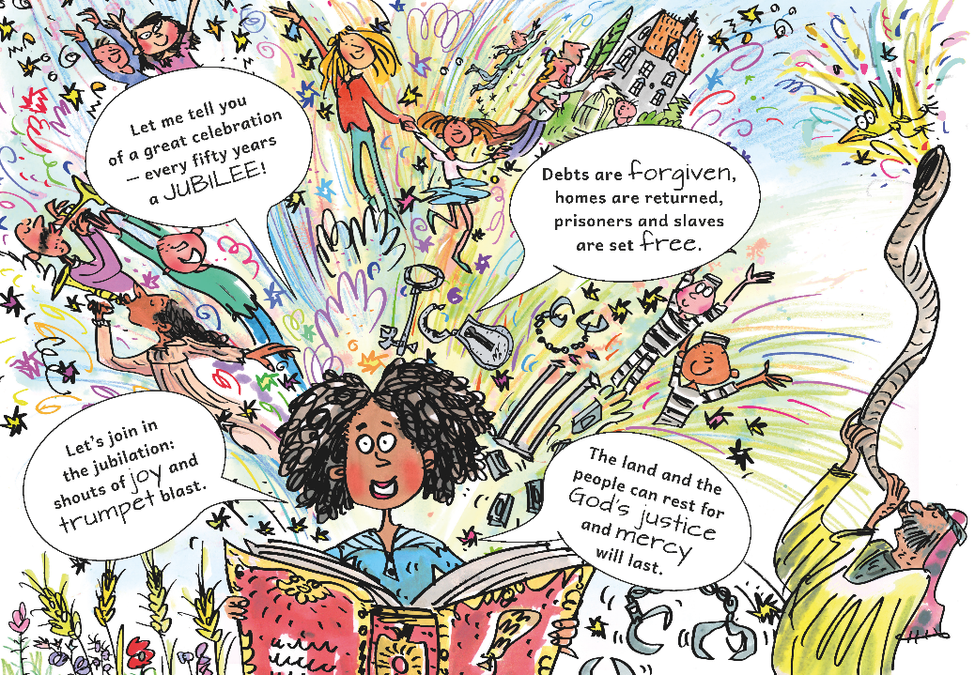

Slide 12
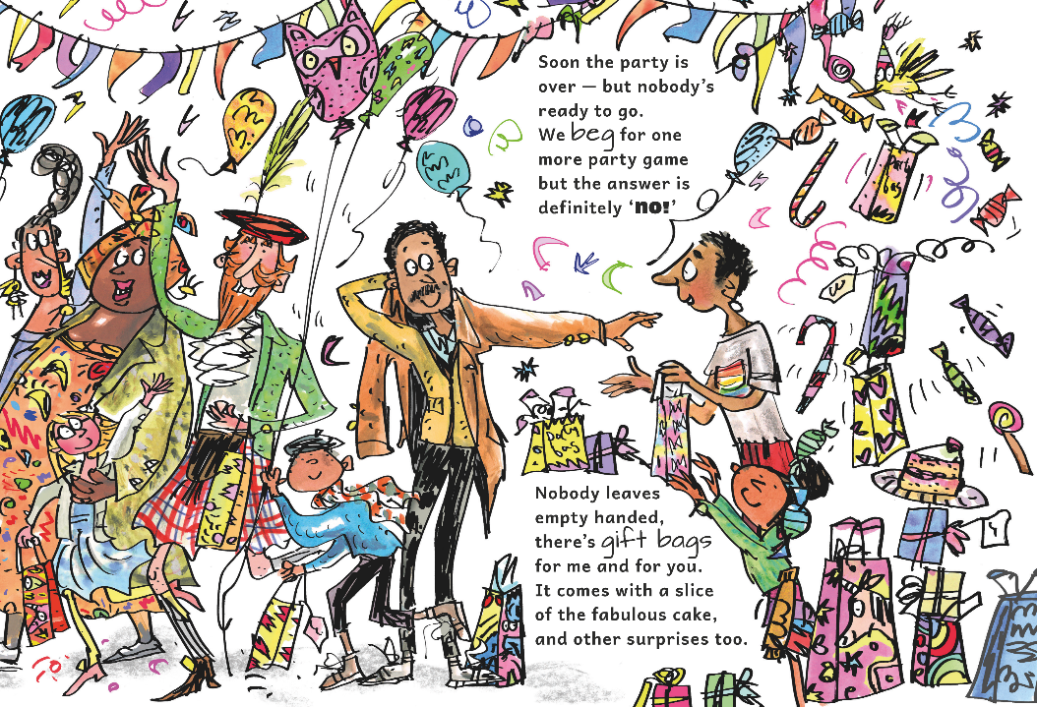

Slide 13
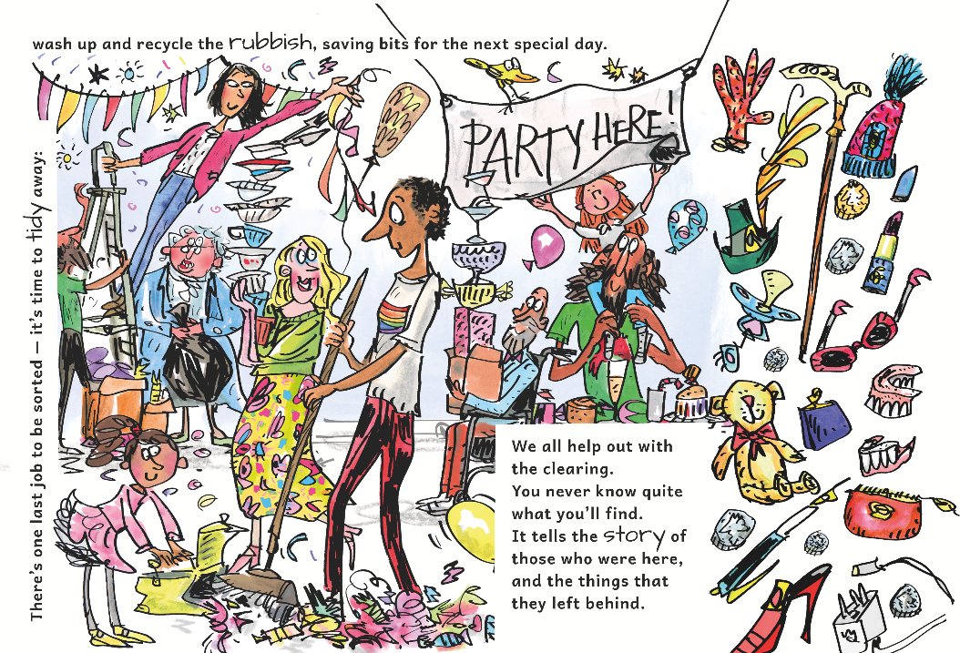

Slide 14
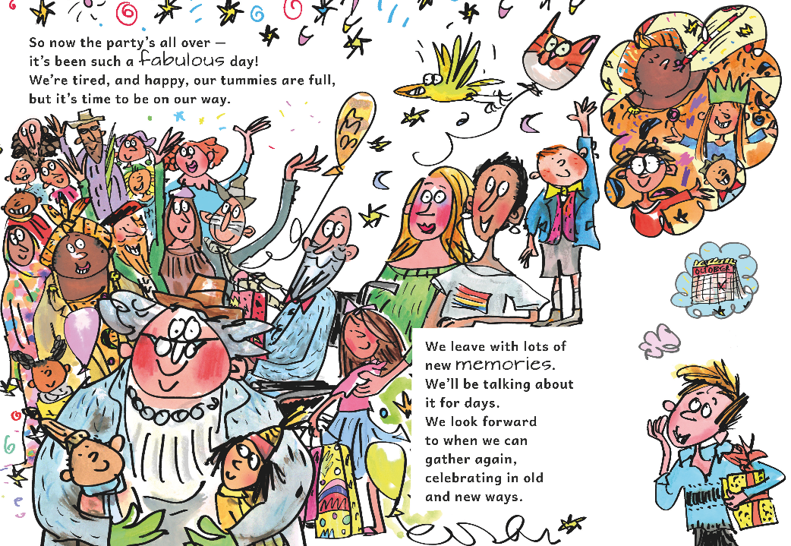

Slide 15

The United Reformed Church will be celebrating its Jubilee throughout 2022 with local, regional and national events. To find out more go to our website: www.urc.org.uk/50
You are warmly invited to join your local church for any of its activities, including worship. You can find your nearest URC here: www.urc.org.uk/find-a-church
By Ruth White and Sam Richards, illustrations by Mark Beech and designed by Sara Foyle

