Slide 1
Stewardship and Discipleship
The Responsibility Is Ours
Notes:
These notes will help you lead this presentation looking at the relationship between Stewardship and Discipleship, and the responsibilities we have as followers of Jesus to make sure we are making the most of our resources in building God’s vision of justice and love for all peoples.

Slide 2
Today, we will look together at:
the role of our church for our members (disciples)
the role of our church for our local neighbourhood (mission)
how we can support these roles financially (stewardship).
Notes:
Explain that discipleship is about recognising and responding to God’s presence in every aspect of your life and that being a church member is about helping each other to do that. Mission is about sharing God's vision of justice and love for all people in the world around us, including our local neighbourhood. Stewardship is about recognising that all we have first comes from God, and so we must use all we have in carrying out God’s Mission and disciples of Jesus. We need to consider the relationship between our Christian living and Christian giving, without reserve, to achieve God’s purposes of love.

Slide 3

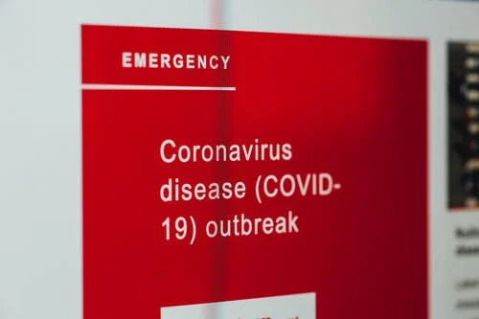
2020 – A different year
Notes:
March 2020 saw the start of lockdown during the Covid-19 crisis, with many churches needing to close their buildings. However, people were resourceful and started to worship and engage in mission in different ways, with some buildings even featuring more prominently in community life. The experience we have all been through gives us an opportunity to take stock and refocus our energies, including in stewardship, on the things that really matter. As disciples of Jesus, the most important thing is sharing the love of Jesus with those around us.

Slide 4
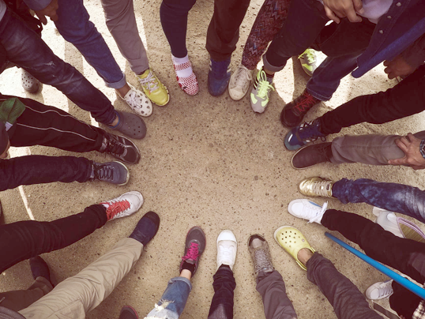
What is our role?
Notes:
We all need to work together:
To celebrate God’s existing presence at work in our lives, both individually and collectively.
To understand the impact which our lives, individually and collectively, have on others.
To build God’s vision of justice and joy for all peoples, starting with our own neighbourhood.
We all need to “put our best foot forward” as we Walk the Way of Jesus together.

Slide 5

Gladness and generosity
https://youtu.be/2-qK6bkRYds
Sharing resources
https://youtu.be/ODNxtvd6dUg
Notes:
Holy Habits by Andrew Roberts and the Bible Reading Fellowship (BRF) is a collection of books and resources on ten habits which held the early Church in Acts together. Two of the habits are “Gladness & Generosity” and “Sharing Resources”. Watch the URC’s videos on each of these Holy Habits together (YouTube links included. Email wtw@urc.org.uk for copies of the films).

Slide 6
What should we resist?
Starting with questions about money.
Focussing on negatives.
Feeling guilty.
Being unclear about what we want to achieve.
Thinking about what we’ve always done.
Notes:
Explain that these are common errors which Christians make when it comes to talking about stewardship and money. We need to begin with questions od discipleship and mission, then move onto money and stewardship.

Slide 7
What should we do?
Start with questions about sharing God’s love.
Focus on positives.
Consider things which give us hope.
Have a clear idea of what our aims are.
Think about new ways of achieving our goals.
Notes:
These points will help us focus on what we need to before we move further into the practicalities of what resources we have and need.

Slide 8
Questions to discuss
What is happening in our church that is good for members?
What is happening in our church that is good for the wider neighbourhood?
If you had to pick one thing for our church to focus its resources on, what would it be? Why?
What should our church’s aims be?
Then, after all that, how can we afford it?
Notes:
Encourage participants to discuss these questions and groups, thinking firstly about what matters to them the most, as a group of gathered disciples of Jesus before thinking about how the priorities they identify are being, or might be pursued practically. Allow time for small groups to feed back to the wider group.

Slide 9

Mission and Ministry Fund
Notes:
Explain that the Ministry and Mission (M&M) Fund is the name given to the general funds of the United Reformed Church which are held at a denominational level. The object of the fund is to provide, in partnership with local churches and Synods, the financial resources needed to train, equip and remunerate ministry and to support centralised services and the world-wide work of the Church. Underlying the fund is the belief that the financial responsibility for this is to be shared throughout the whole of the Church and contributions to the fund are made as a response to the gracious and plenteous giving of God.
Our church currently gives ??? in annual M&M contributions.
If M&M and the services it supports are all about equipping the whole people of God, how much should we be giving and receiving from it?
How can we use what we receive to share the love of God in our wider community?

Slide 10
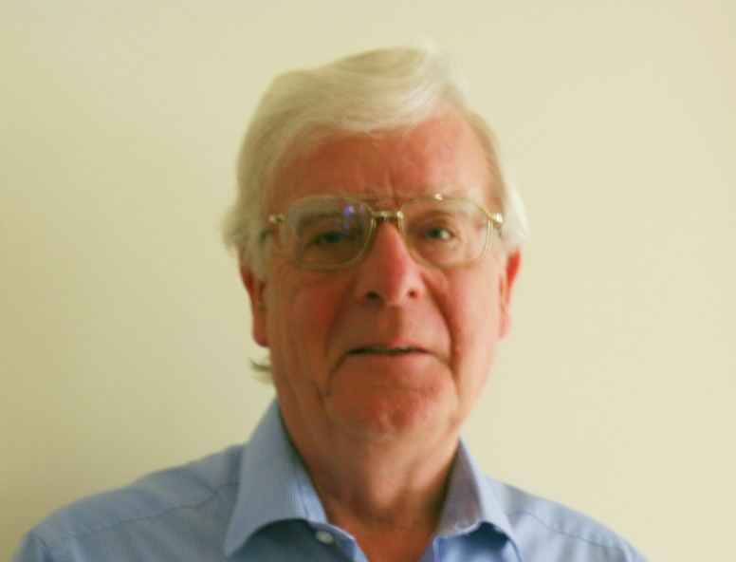
From Ian Hardie, the URC Treasurer
Notes:
Share this message from the URC Treasurer, Ian Hardie: Thank you for your giving to your local church. Financially, this giving is the lifeblood of your own church and of the whole United Reformed Church across England, Scotland and Wales. It is this personal giving that enables your local church treasurer to pay your church’s bills. Typically, the largest of those ‘bills’ is the contribution your local church pays to the URC Ministry and Mission Fund. This Fund meets the central costs of the United Reformed Church. The total annual budget is around £20 million and is approved each year by Mission Council. Over 80% of this money is spent on ministers and church related community workers – their training, stipends and pensions. But the other 20% also achieves an enormous amount on behalf of us all. General Assembly 2020 was severely constrained because of the Covid-19 lockdown, but the reports written for General Assembly are available on the URC website, and they paint pictures of all the work that has been done in our name over the last two years and much of that work is ongoing.

Slide 11
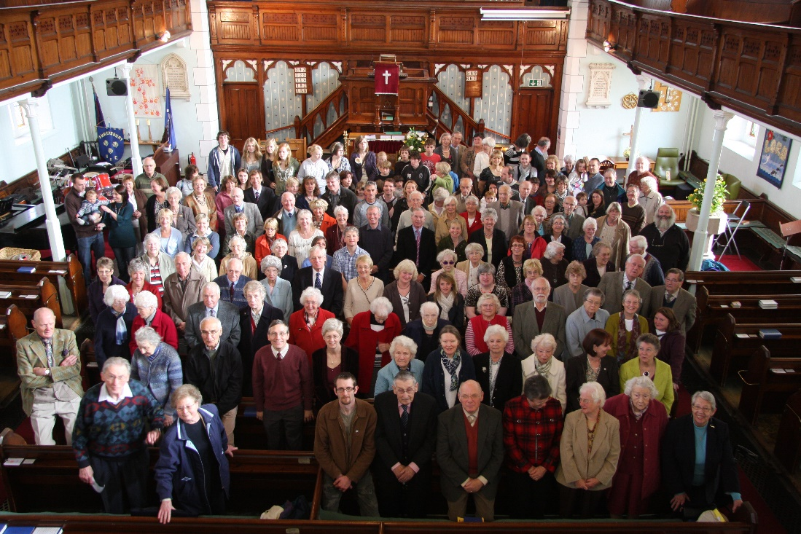
Name of church/pastorate
How much does it cost each week/month to run our church?
Have a guess!
Notes:
Replace the image with one of your own congregation and encourage participants to take a guess at how much it costs to run your church weekly/monthly.

Slide 12
Weekly expenditure
Church and services £xxx
Ministry and outreach £xxx
Building maintenance £xxx
Utilities and insurance £ xx
Office and Staff costs £ xx
TOTAL £x,xxx
Notes:
Customise this slide to show participants the weekly expenditure of your church at a glance.

Slide 13
Monthly expenditure
Church and services £xxx
Ministry and outreach £xxx
Building maintenance £xxx
Utilities and insurance £ xx
Office and Staff costs £ xx
TOTAL £x,xxx
Notes:
Customise this slide to show participants the monthly expenditure of your church at a glance.

Slide 14
Income shown weekly
Planned giving £xxx
Gift aid from HMRC £xxx
Fundraising £xxx
Room hire etc £xxx
Other income £ xx
TOTAL £x,xxx
Notes:
Customise this slide to show participants the weekly income of your church at a glance.

Slide 15
Income shown monthly
Planned giving £xxx
Gift aid from HMRC £xxx
Fundraising £xxx
Room hire etc £xxx
Other income £ xx
TOTAL £x,xxx
Notes:
Customise this slide to show participants the monthly income of your church at a glance.

Slide 16
The challenge
Weekly/monthly Expenditure £x,xxx £x,xxx
Weekly/monthly Income £x,xxx £x,xxx
SHORTFALL / SURPLUS (delete as appropriate) £xxx
Think about the priorities we identified earlier. How might we follow these up, given this situation? Do we need to raise more money? Do we need to give something up in order to achieve something else?
Notes:
Customise this slide to compare your church’s income with expenditure and display your current shortfall or surplus. Encourage participants to consider the priorities they identified in their small group discussions earlier, and to think about how these might be followed-up given the financial situation, needs and requirements of the church as they currently stand. Perhaps more time in discussion groups might help.

Slide 17
What might giving look like?
Giving our money, time and talents helps the mission and ministry of our church
We need an AVERAGE of an extra — £x per person per week (£x per month).
BUT we’re not asking everyone to give that figure because that would be unfair.
We are asking everyone to consider their giving carefully and prayerfully.
Notes:
Customise this slide to explain the financial needs of your church. Emphasise that we are not asking everyone to give this amount, but inciting everyone to prayerfully consider their giving.

Slide 18
We should not:
give everything up blindly
give so much that we starve, freeze, get ill …
worry about what we don’t have
worry about goals which cannot be achieved.
Notes:
Explain that it is not the aim of this session to say that we should hand over everything we have to the church without due consideration, or attempt to achieve things which we simply cannot.

Slide 19
We should:
be aware of what we give and why
consider an increase in giving, if we can afford it
consider giving 5p for every pound of our income, if we can afford it
be grateful for that which we do have
think and act realistically.
Notes:
Explain that this session is about thinking carefully about what we ought to be focussing on as a church, consider our financial situation and think about how our stewardship might help us use what we have to best of our ability in sharing God's love throughout our community (the Mission of God). If we can afford it, an increase in our giving, perhaps based around 5p for every pound of our income, could really help, but only if, after prayer and conidiation, this is achievable for us.

Slide 20
What might giving look like?
Giving per £1 | Weekly take home pay
 | £50 | £100 | £175 (basic state pension) | £500
1p | 50p | £1 | £1.75 | £5
3p | £1.50 | £3 | £5.25 | £15
5p | £2.50 | £5 | £8.75 | £25
10p | £5 | £10 | £17.50 | £50
Notes:
This chart gives some examples of what giving might look like for people with a weekly income if they were to give a certain amount for every pound they receive.

Slide 21
What might giving look like?
Giving per £1 | Monthly take home pay/pensions
 | £250 | £800 | £750 (basic state pension) | £2500
1p | £2.50 | £8 | £7.50 | £25
3p | £7.50 | £24 | £22.50 | £75
5p | £12.50 | £40 | £37.50 | £125
10p | £25 | £80 | £75 | £250
Notes:
This chart gives some examples of what giving might look like for people with a monthly income if they were to give a certain amount for every pound they receive.

Slide 22
What else do we spend money on?
A coffee out £3.50
Netflix £8 per month
Weekly newspapers £10.50
Bottle of wine £10.00
Meal at Pizza restaurant £20.00
Fast food, fashion, mobile upgrade, gym membership …
How does our giving to our church compare?
Notes:
Here are some things which people regularly spend money on, inviting us all to consider how we give to our church in comparison.

Slide 23
Based on what we’ve seen, what should we do now?
Notes:
Encourage participants to discuss this in small groups and be prepared to share their thoughts with the wider group.

Slide 24
Steps we can all take
Prayerfully review the amount and frequency of our giving.
Use the Gift Aid scheme.
Use standing orders.
Avoid cheques or cash where possible (although we are still very grateful for these).
Notes:
Explain that these are some steps we can all take to help our church reach its financial goals, including using the Gift Aid scheme which enables the church to claim back money for ever pound donated by taxpayers, at no cost to the church, setting up standing orders which enable donations to be made automatically, and avoiding cheques or cash where possible as these require additional administration. Be sure, though to emphasise that we are still very grateful for these. Further information on giving to the United Reformed Church can be found in this online booklet: https://urc.org.uk/images/Finance/Stewardship/Giving-to-the-church.pdf
.

Slide 25
What we give…
is between us and God.
What God expects…
is that each of us will shoulder our responsibility as a member of our church family to the best of our ability in carrying out God’s mission.
Because
The Responsibility Is Ours
Notes:
Explain that what we give is a matter for us and God to consider together, but that doing so can help us make the most of all we have in carrying out God’s mission because the responsibility is ours.

Slide 26
Stewardship and Discipleship
The Responsibility Is Ours
Notes:
These notes will help you lead this presentation looking at the relationship between Stewardship and Discipleship, and the responsibilities we have as followers of Jesus to make sure we are making the most of our resources in building God’s vision of justice and love for all peoples.

