Slide 1
Jubilee a time of celebrating Hospitality
URC 50 Anniversary

Slide 2

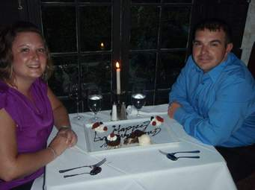
HHh Hospitality

Slide 3
There is a difference between Service and Hospitality

Slide 4
Service is to practice what you were taught

Slide 5
Hospitality is to think of how people feel

Slide 6
Service is about you and what you learned

Slide 7
Hospitality is about others and how they feel

Slide 8
Hospitality is not mere service but rather a way to make people happy, respected, and dignified. It is stepping in their shoes and trying to help them, or even get them out of their misery.

Slide 9
Two Biblical stories about Hospitality:
The good Samaritan ( Luke 10: 25-37)
The story of Mary and Martha,
( Luke 10 :38-42)

Slide 10
Henry Neumann, says
Hospitality is a fundamental attitude towards our fellow human beings, it means to create a free space where the stranger can enter and become a friend instead of an enemy.

Slide 11
The Good Samaritan Story
The Samaritan was the hospitable one, while the Priest and the Levite were far from Hospitality. Those who should have been hospitable missed the point

Slide 12
Mary and Martha Story
Martha represents the real hospitable person. Martha symbolizes the model of hospitality
Jesus did not appreciate all this Hospitality

Slide 13
Hospitality is not mere action, But rather with what spirit we do hospitality, affects the impact of hospitality.

Slide 14
When we get in this new free space we are changed, the helped and the helper

Slide 15
Hospitality is to take the risk in stepping into a new space

Slide 16
Hospitality is not to change people but to offer them space where change can take place; spiritual growth and transformation

Slide 17
Hospitality is not an act of pity but is rooted in our faith

Slide 18
It is not a troubled experience but an experience where we ask our lord what do you need from us and how do you want us to live our faith?

Slide 19
Hospitality is one way to cure the world from radical exclusive attitudes

Slide 20
With understanding leadership role in terms of hospitality then to be a leader is to
Recognize that we have received the hospitality of Christ and we are living our leadership role in the church due to experiencing this hospitality
Being invited ourselves to the table of hospitality, we reflect this hospitality in our paradigm of leadership

Slide 21
We are not the lords of the table or those who invite but we are invited as well and we will always learn from what God offers us around the table. We sit in the circle of the free space to learn anew how to be the church today.

Slide 22
When we understand leadership as a call to live hospitality :
We are not centered around what we understand things but open to learn anew how to live our leadership
We continually seek change .
We become attentive to hear God’s voice in our circumstance as God opens our eyes to new styles of leadership

Slide 23
As the Presbyterian Church In the Middle NESSL the war situation opened our eyes to new realities
The church is called to go outside its walls
As leaders we are called to create new spaces of Hospitality
As leaders we are called for new ways of hospitality
Notes:
Rev. Ibrahim in Aleppo and Refugee schools.

Slide 24
God surprises us with new attitudes
God Surprises us in new places

