Slide 1
Jubilee a time of Celebrating life in the spirit

Slide 2
Jeff Bezos, founder and CEO of Amazon. com

Slide 3
It is harder to be kind than Clever

Slide 4
David Bosch in his book Transforming Mission
“Mission is not only about saving souls but changing the world.” To be called today to transforming discipleship, we are challenged to think of our impact on the world.

Slide 5
Galatians 5:25
If we live by the Spirit, let us also walk by the Spirit. ²⁶ Let us have no self-conceit, no provoking of one another, no envy of one another.

Slide 6
To live in the spirit is to live in Freedom.

Slide 7
To live in the spirit is to live like our lord and to have a life style that reflects Christ

Slide 8
To live in the spirit is to serve outside the walls of the church.

Slide 9
To live in the spirit is to carry the cross with our lord

Slide 10
To live in the spirit is to live in hope.

Slide 11
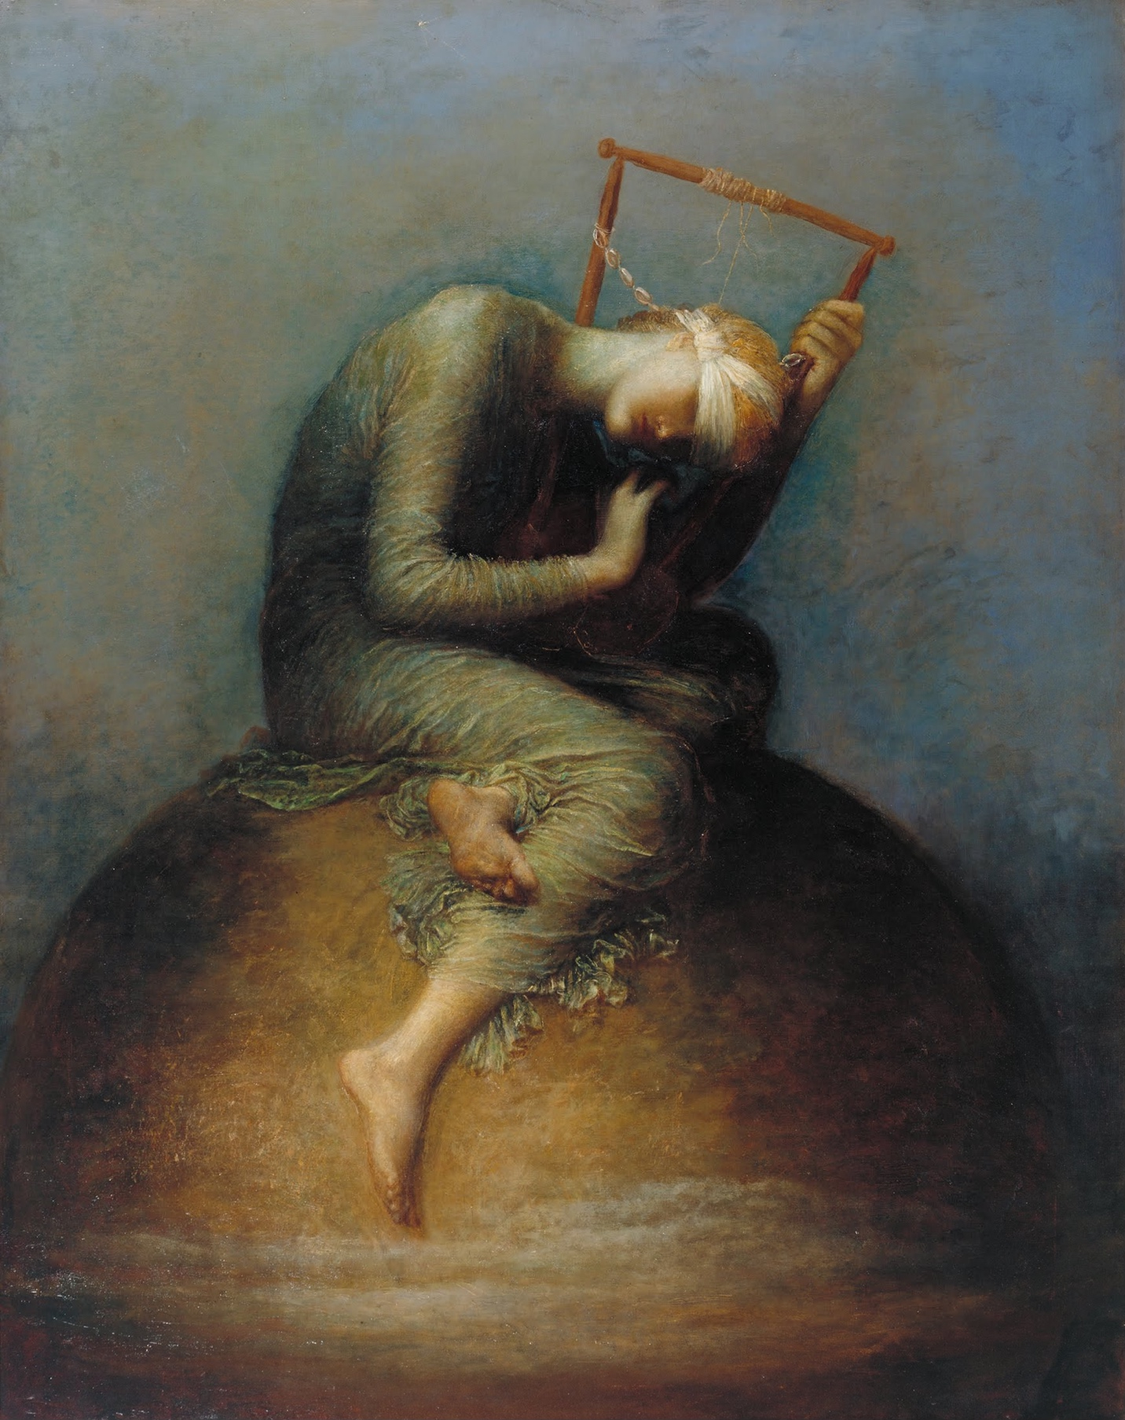
HOPE
George. F. Watts

Slide 12
To live in the spirit is to be a bridge of reconciliation

Slide 13
To live in the spirit is to be called for new Imagination of how to live our faith and do mission

Slide 14
The church is called for new Imagination of how to live its faith and do mission:
Together we long for renewed imagination of what being the church in communion could mean —for our world, in our time.
We need new imagination to live together in ways that would embrace our unity not only as gift but also as calling. We need new imagination to dream a different world, a world where justice, peace and reconciliation prevail.
We need new imagination to practice spiritualities of resistance and prophetic vision, spiritualities in service of life, spiritualities formed by the mission of God.

Slide 15
To live in the spirit is to be called for discernment, confessing, witnessing and reforming

Slide 16
To live in the spirit is to Witness for Justice

Slide 17
To live in the spirit is to promote dialogues of life

Slide 18
Today is a time where we gain strength as we come together and strengthen one another
It is a time of celebration as we discover the blessings of togetherness
It is a time of Celebration as we recognize how God could send us out to a broken world
It is a time of Celebration as we do justice, love kindness, and to walk humbly with your God”
It is a time of witnessing to God of Life…to be challenged by the Holy spirit.

