Slide 2
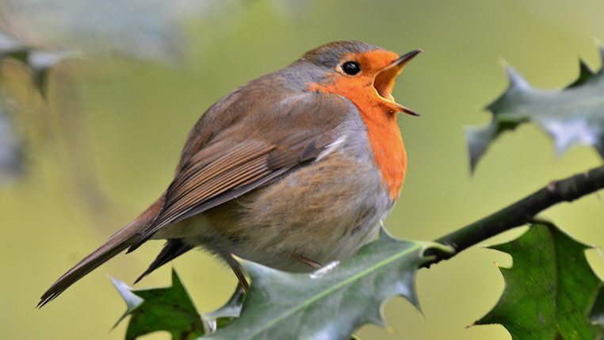

Slide 4
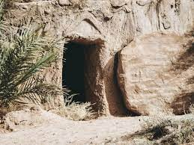
Mary ‘went to the tomb and saw that the stone was moved away from the entrance’.
Greek word = blepo
‘she saw with her eyes’ or ‘noticed’ … ‘observed’.

Slide 5
Simon Peter ‘bent down to look in and saw the linen wrappings lying there.
Greek word = thereo
‘to see and to wonder’ ... ‘to be curious’ … ‘to theorise’

Slide 6
‘the other disciple … saw and believed’.)
Greek word = choreo
‘to realise’ (‘I see!’, in the sense of ‘the penny has dropped’).

Slide 7
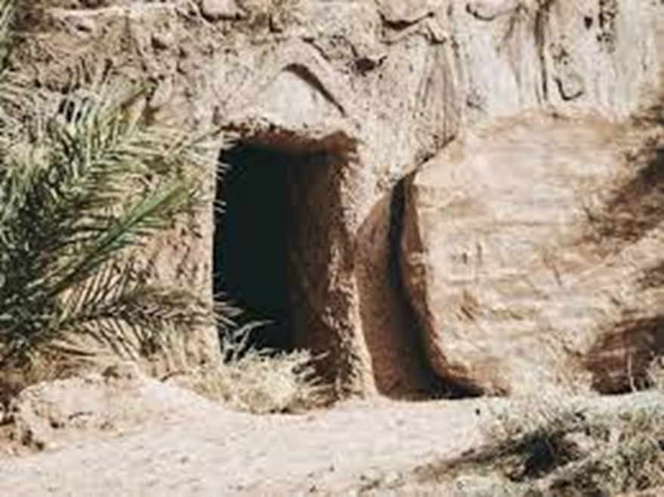
3 WAYS OF SEEING …
To observe, notice
To wonder, reflect, be curious
To realise or understand

Slide 9
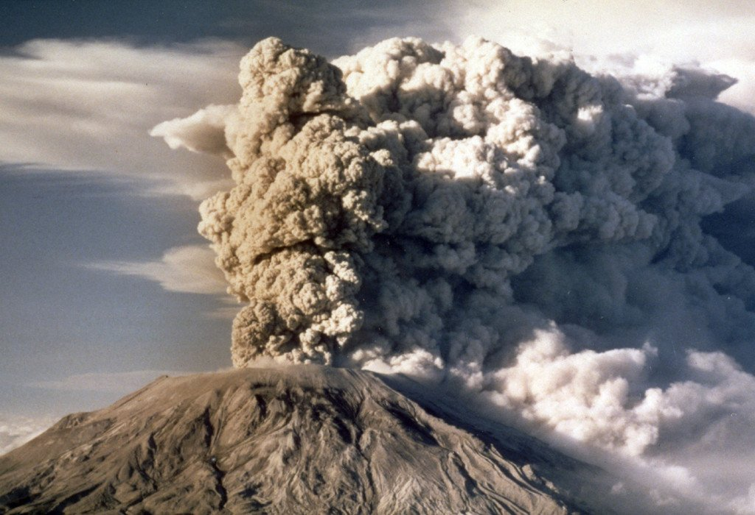

Slide 10
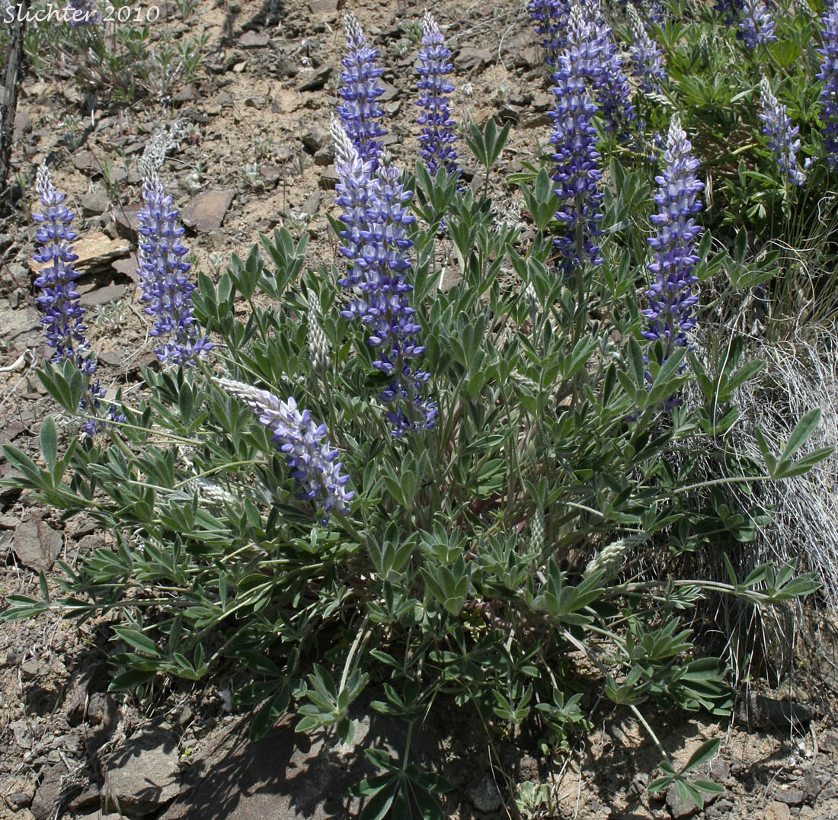

Slide 11
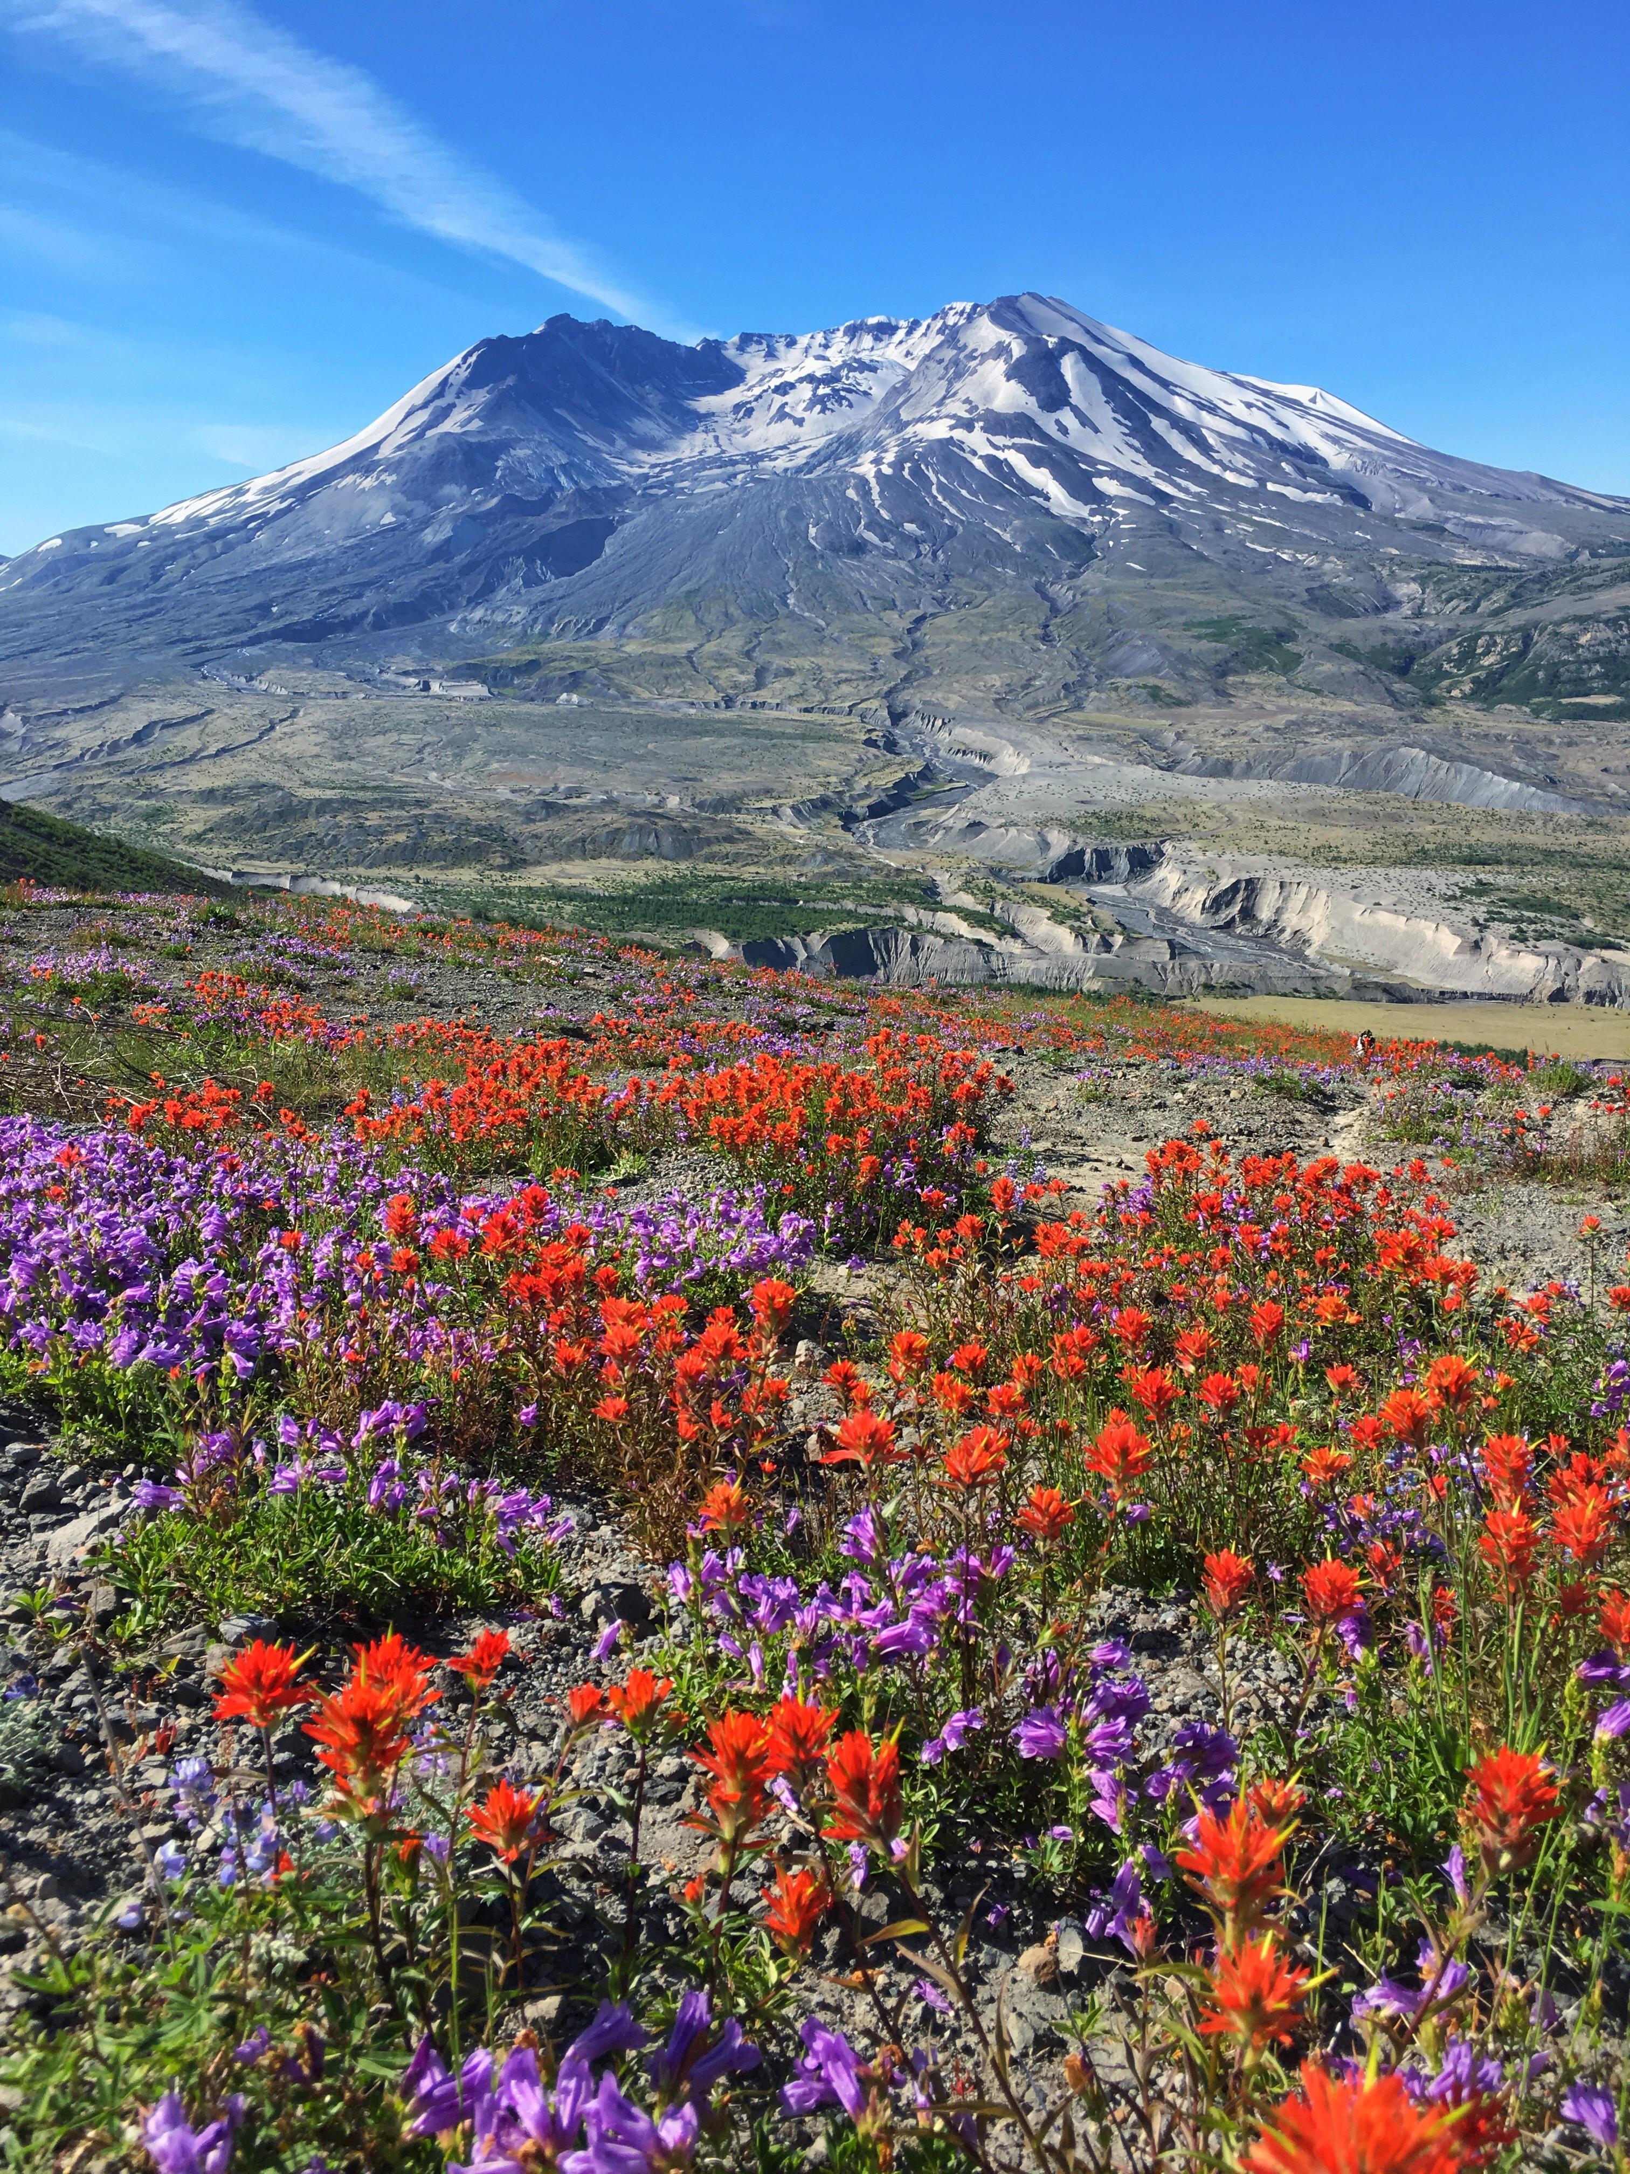

Slide 12
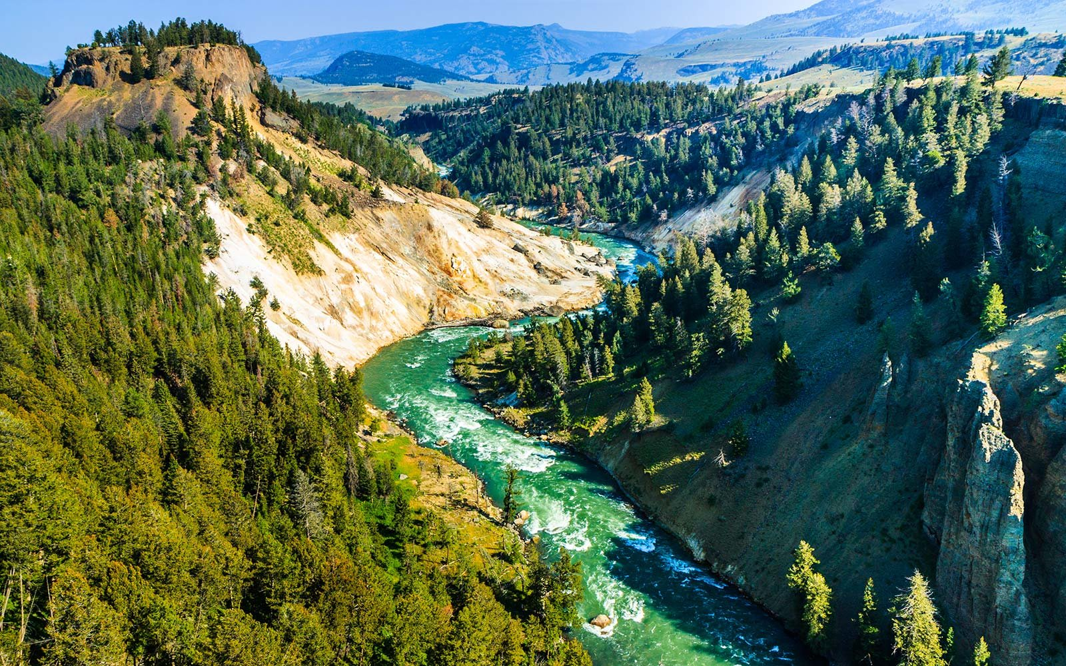

Slide 13
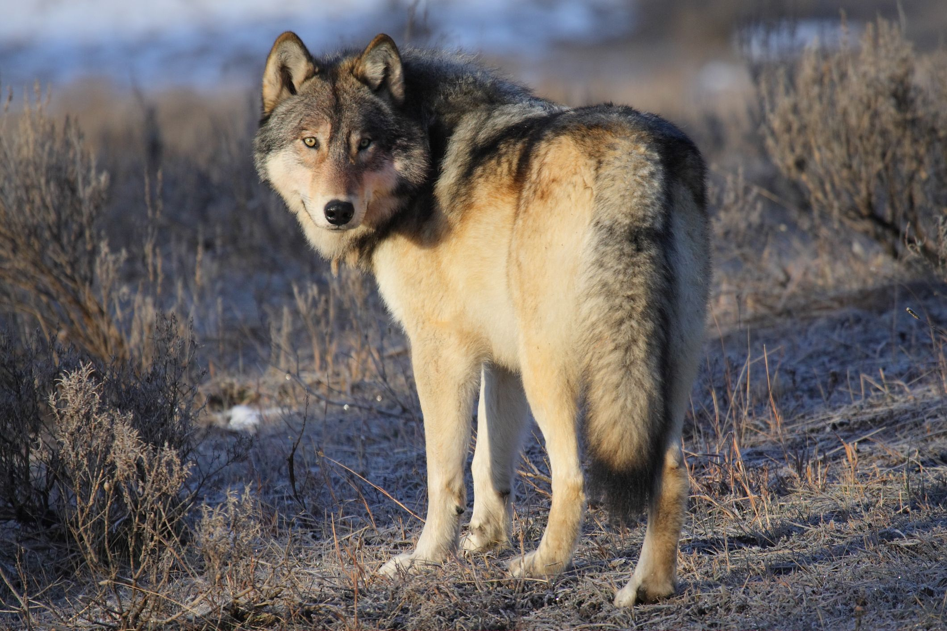

Slide 14
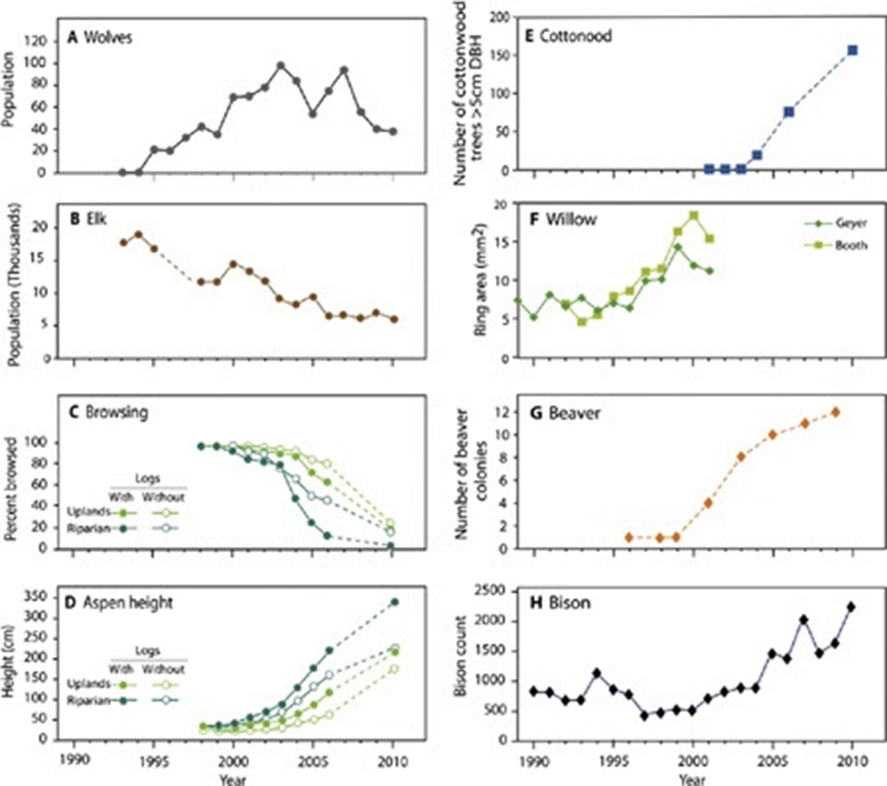

Slide 15
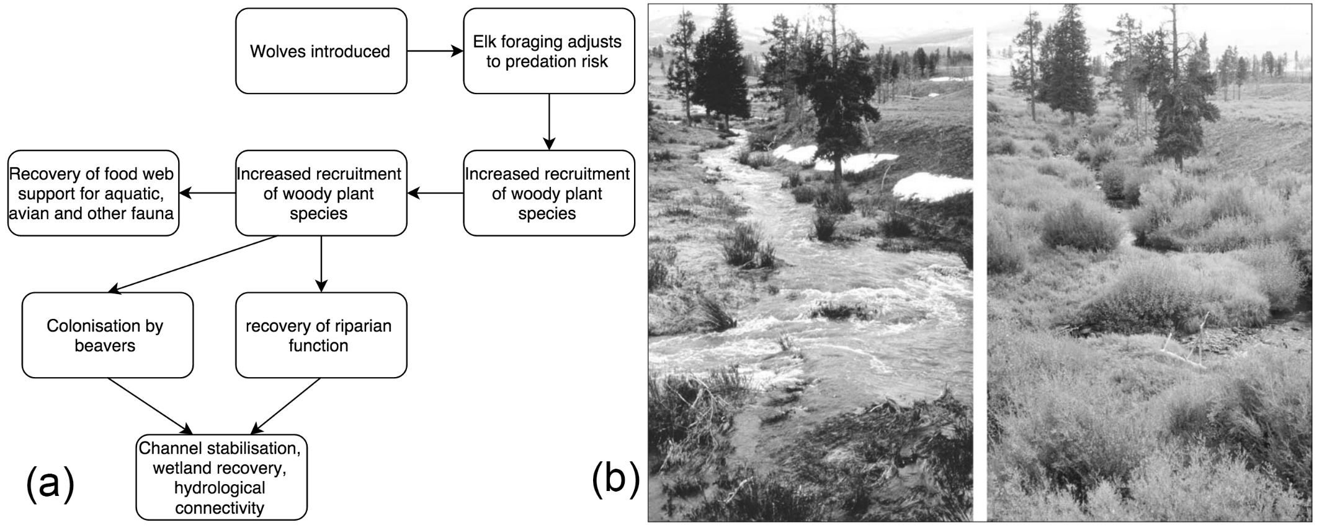

Slide 16
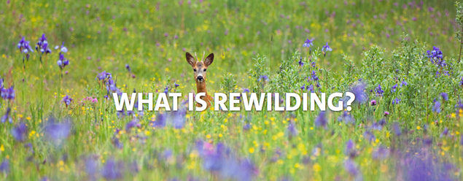

Slide 17
Rewilding …. a powerful metaphor for:
what God is doing in the Church …
rediscovering the adventure of faith …
the biodiversity of church that emerges as we focus on following Jesus together …

Slide 18

‘… a good metaphor engages the imagination, casting the familiar in a new light and revealing the previously invisible or unconsidered.’ (Rewilding the Church, Aisthorpe)
‘… a metaphor proceeds by having an odd, playful and ill-fitting match to its reality, the purpose of which is to illuminate and evoke dimensions of reality which will otherwise go unnoticed and therefore unexperienced.’ (Cadences of Home, Brueggemann)

Slide 19
‘We live our lives before the wild, dangerous, unfettered and free character of the living God.’
(Walter Brueggemann, Commentary on Jeremiah: Exile and Homecoming)

Slide 20
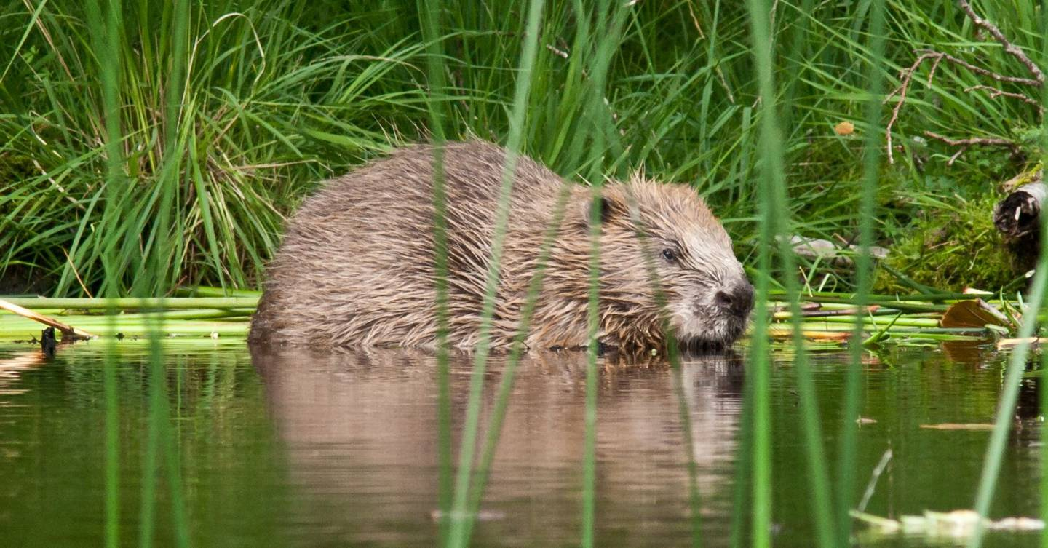

Slide 21
3 WAYS OF SEEING …
To observe, notice
To wonder, reflect, be curious
To realise or understand

Slide 23
‘… a good metaphor engages the imagination, casting the familiar in a new light and revealing the previously invisible or unconsidered.’ (Rewilding the Church, Aisthorpe)
‘… a metaphor proceeds by having an odd, playful and ill-fitting match to its reality, the purpose of which is to illuminate and evoke dimensions of reality which will otherwise go unnoticed and therefore unexperienced.’ (Cadences of Home, Brueggemann)

Slide 24
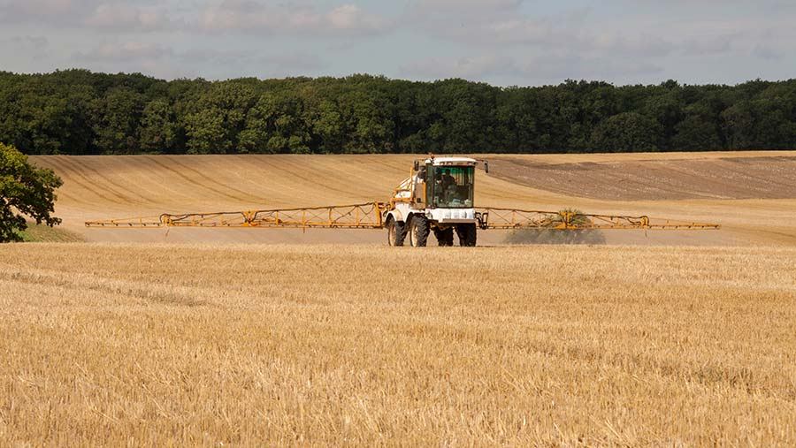

Slide 25
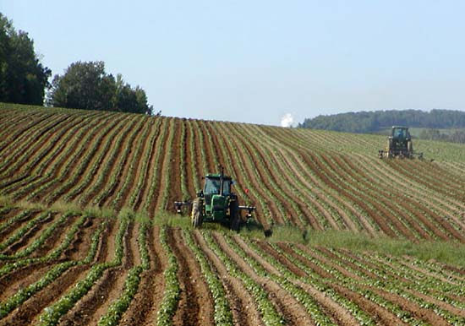
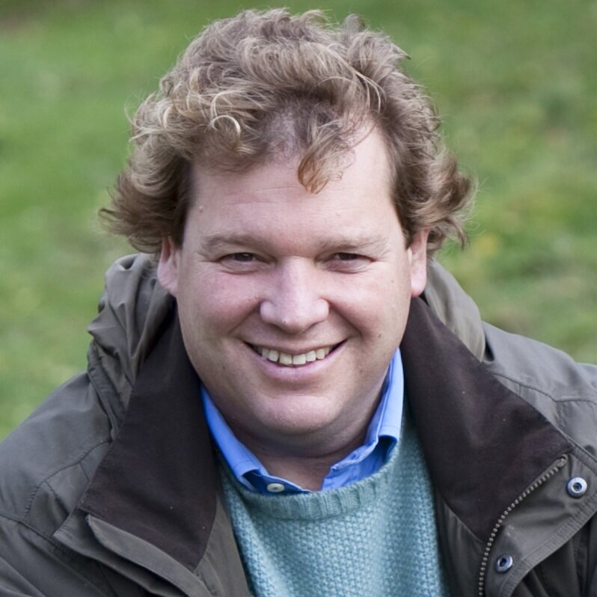
‘We had been doing what every modern farmer is supposed to do: rationalise, intensify, diversify and, if possible, spread the fixed costs over a larger area.’

Slide 26
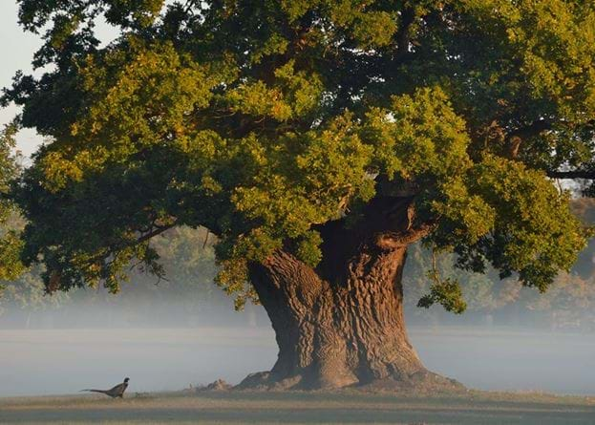
Who’s timescale do we work to?

Slide 27
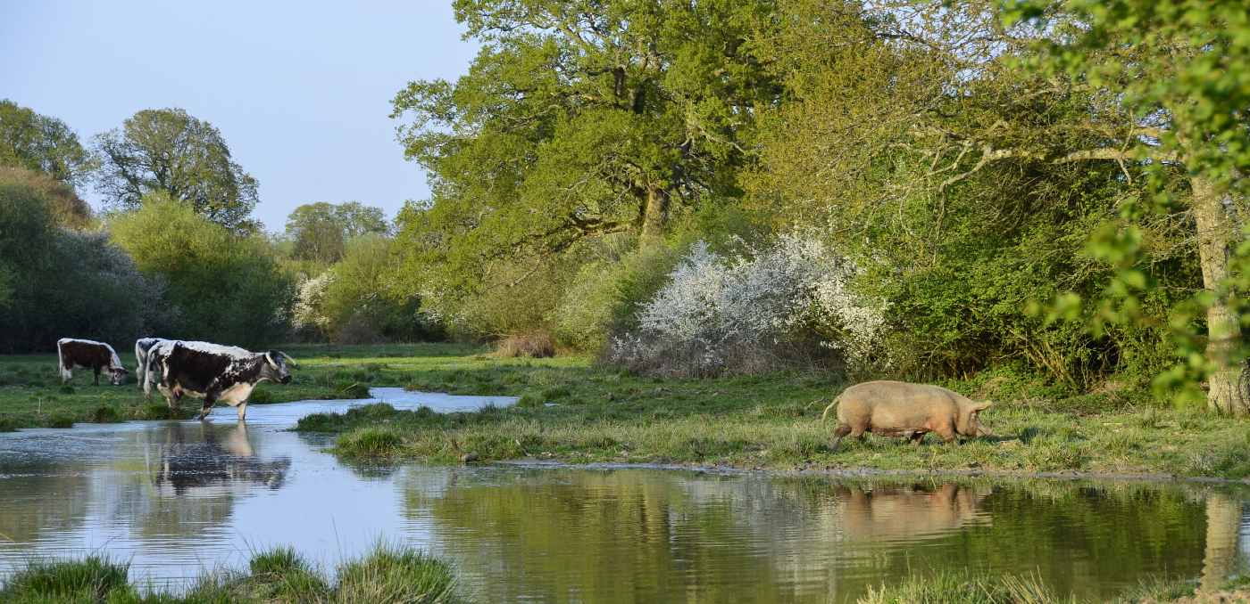
Natural disturbance …

Slide 28
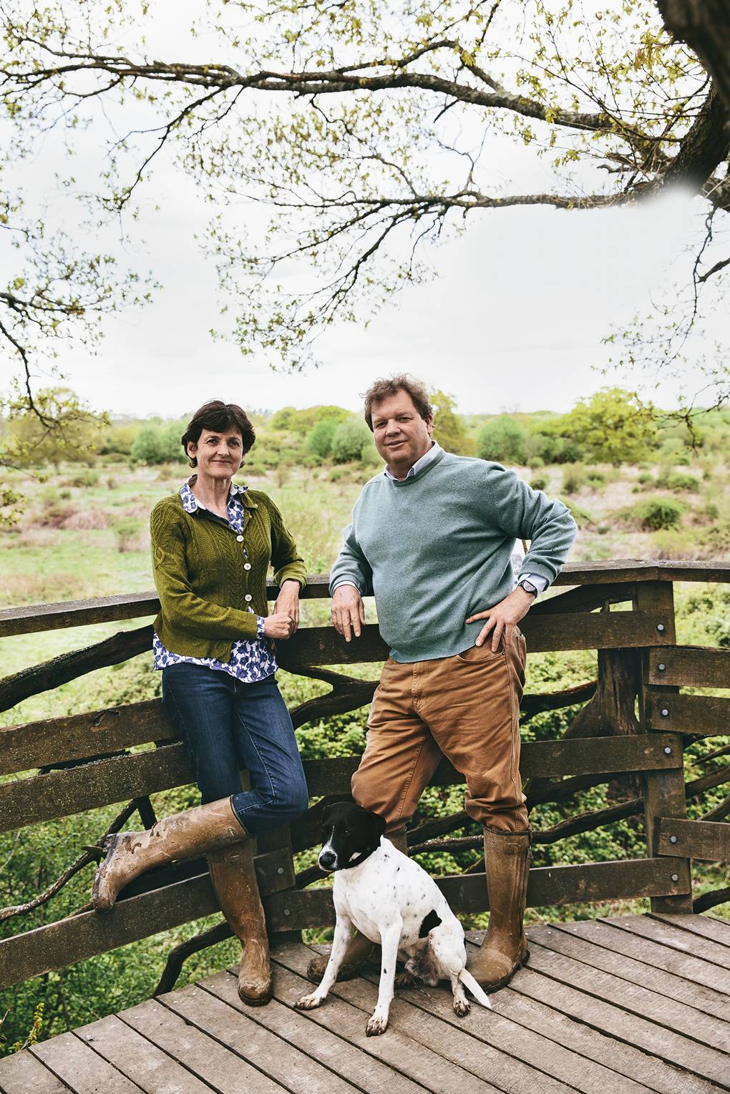
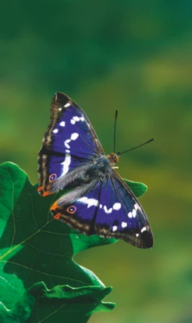
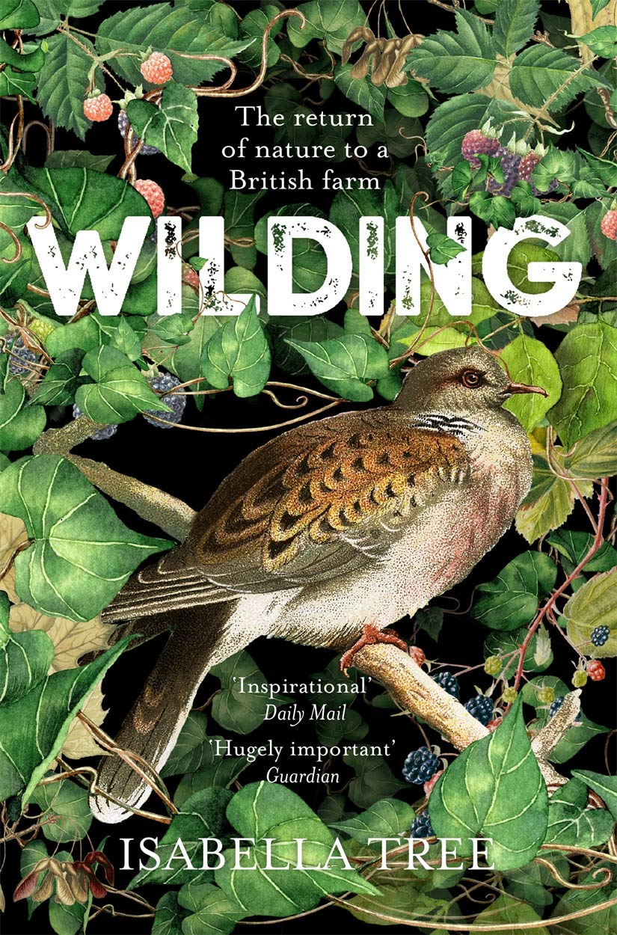

Slide 29
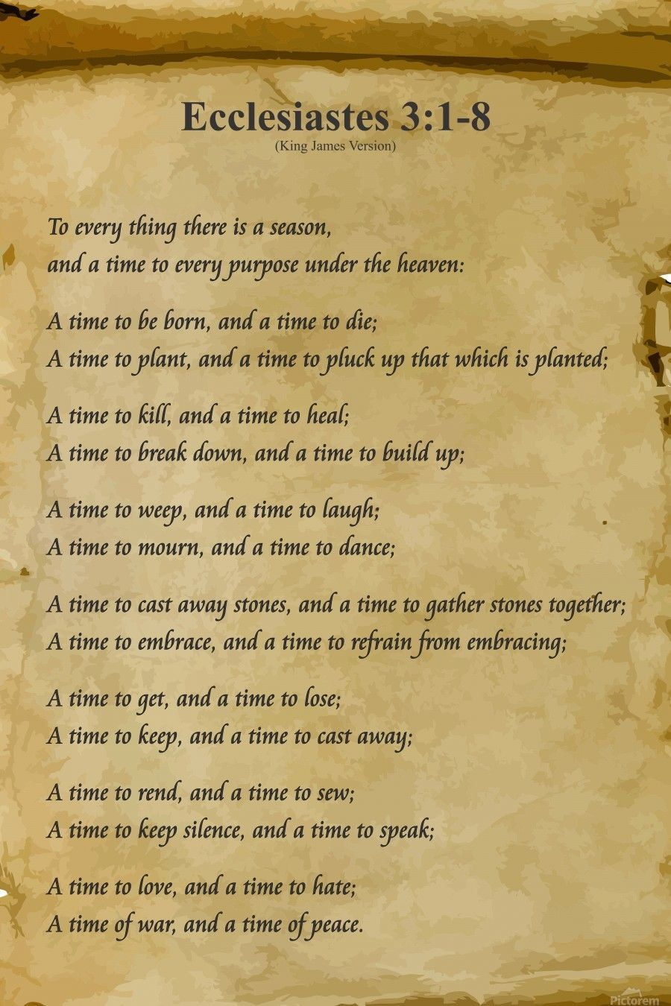
A time to persevere and a time for stopping;
A time for knuckling down and a time for stepping back, looking afresh, reimagining …

Slide 30

Rewilding needs leaders who are attentive …
‘contextual intelligence’

Slide 31


Slide 32
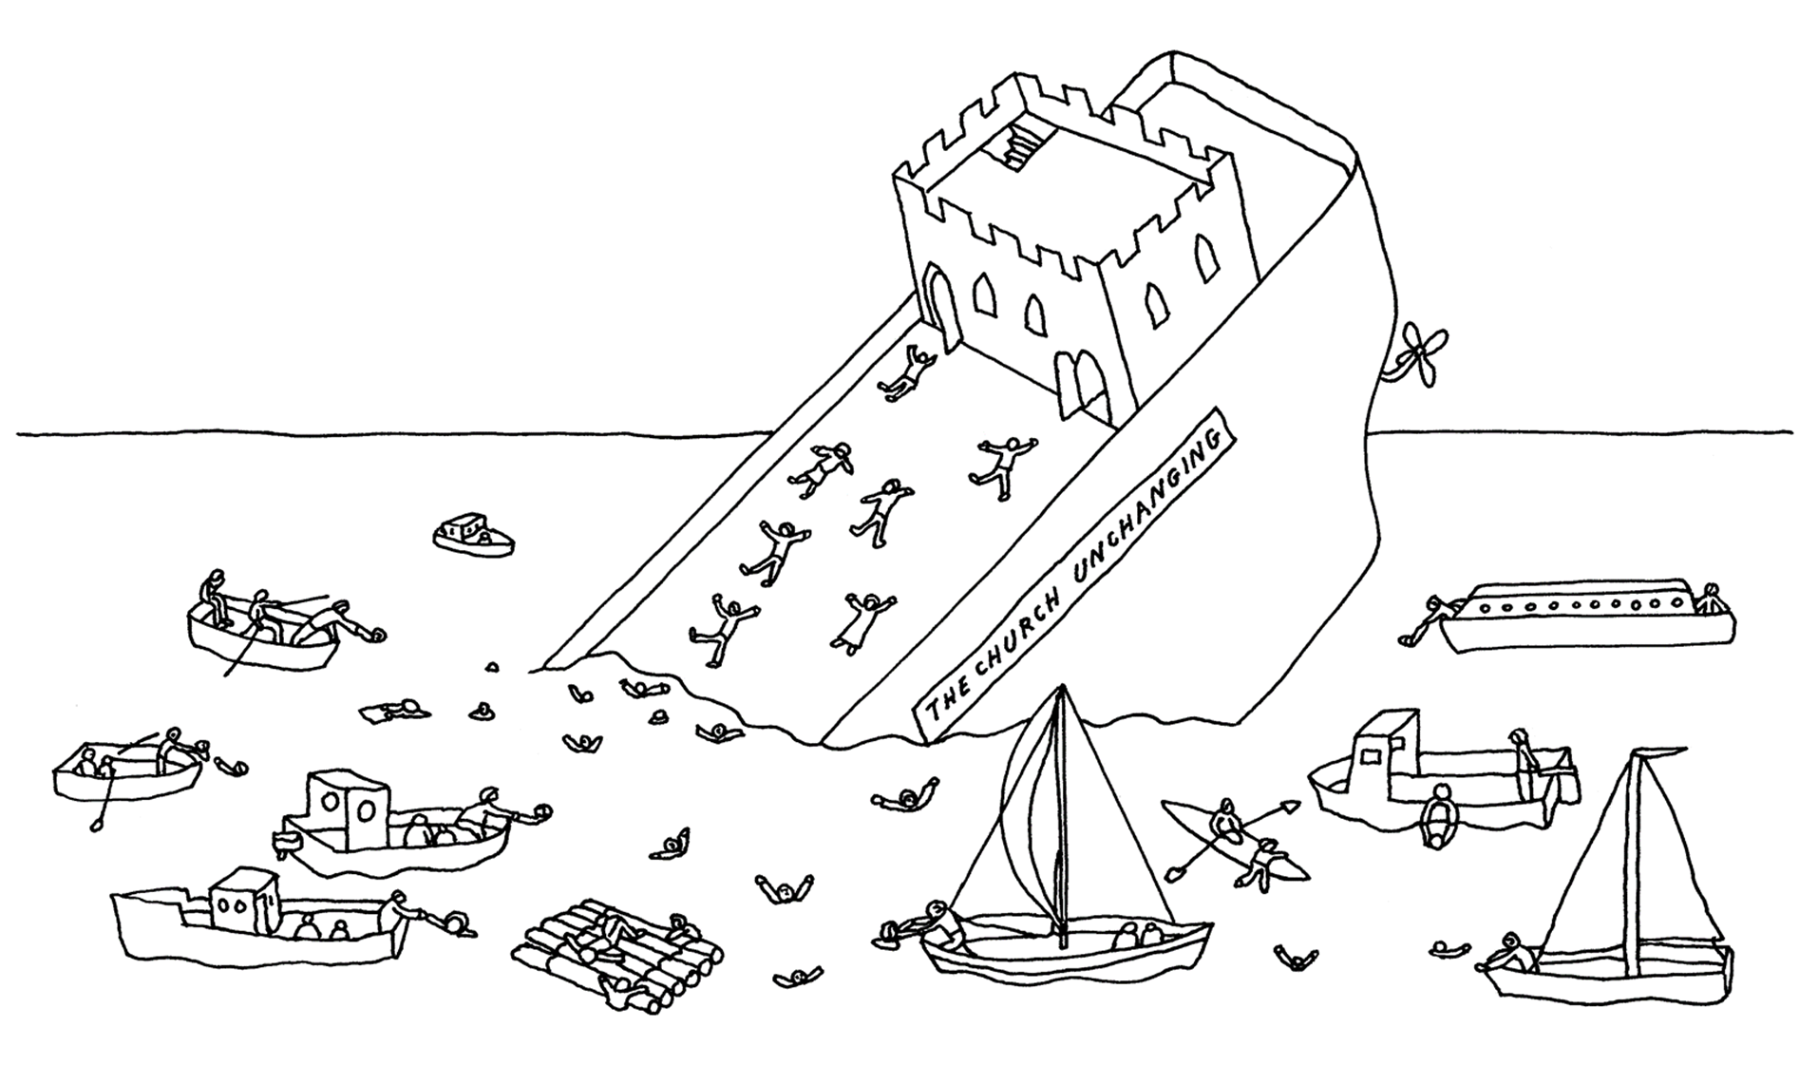

Slide 33
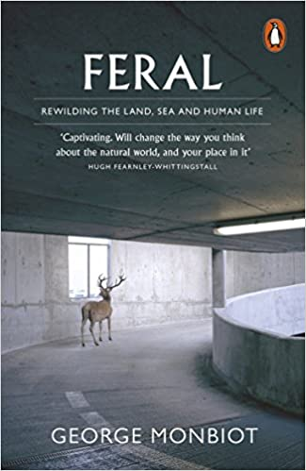


Slide 34
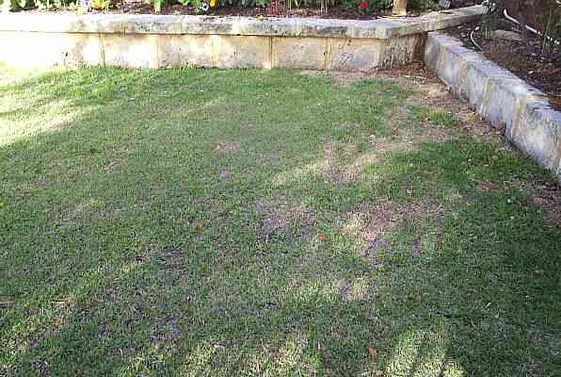
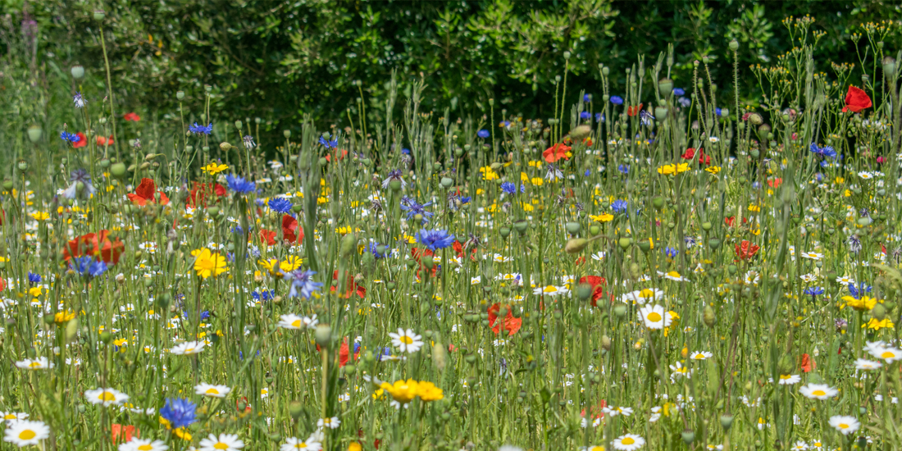

Slide 35
3 WAYS OF SEEING …
To observe, notice
To wonder, reflect, be curious
To realise or understand

Slide 36
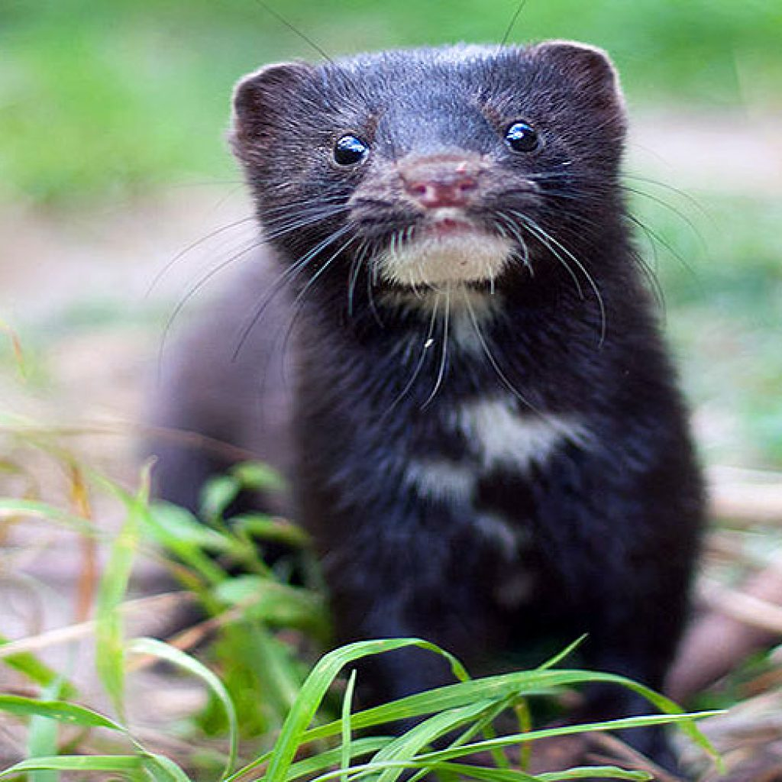
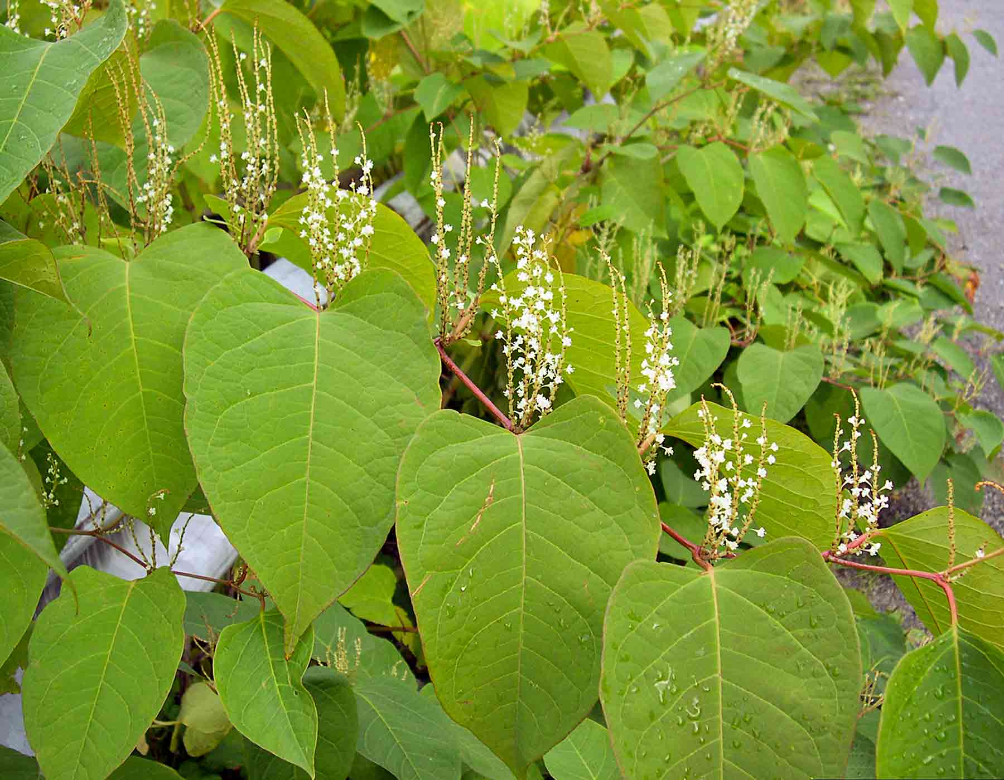
Invasive species

Slide 37
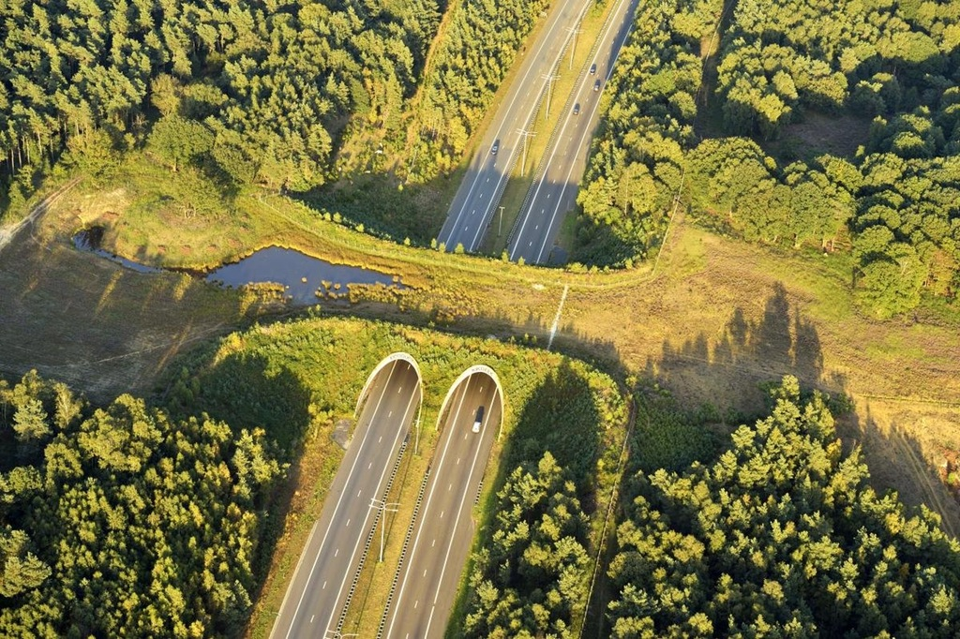

Slide 38
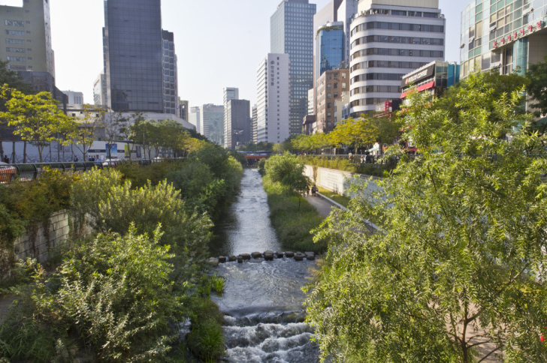

Slide 39
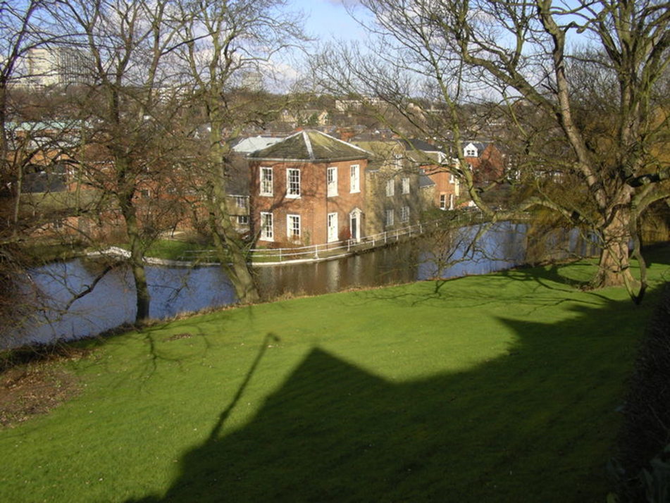
‘Daylighting’: reconnecting with streams of living water …

Slide 40

‘Daylighting’: reconnecting with neglected streams
Six great traditions:
Contemplative
Holiness
Charismatic
Social Justice
Evangelical
Incarnational

Slide 41
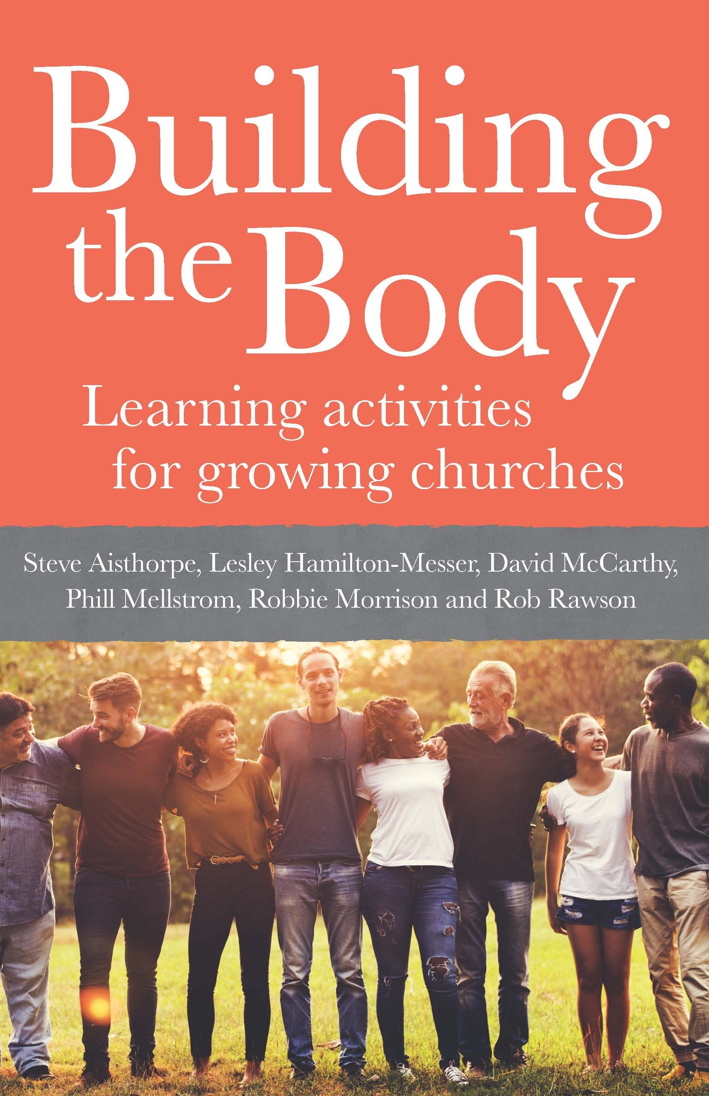

Slide 42
3 WAYS OF SEEING …
To observe, notice
To wonder, reflect, be curious
To realise or understand

