Slide 1

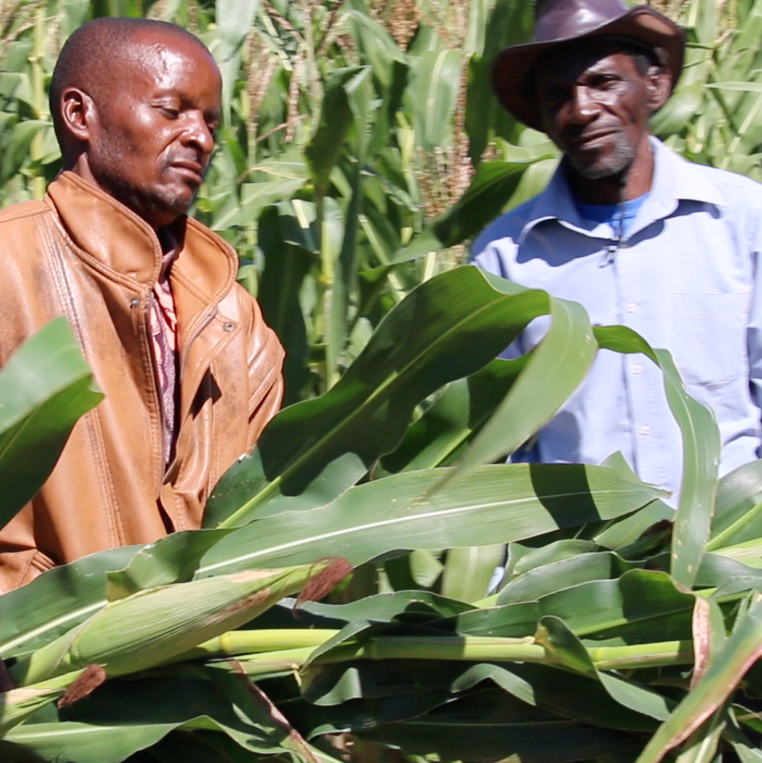
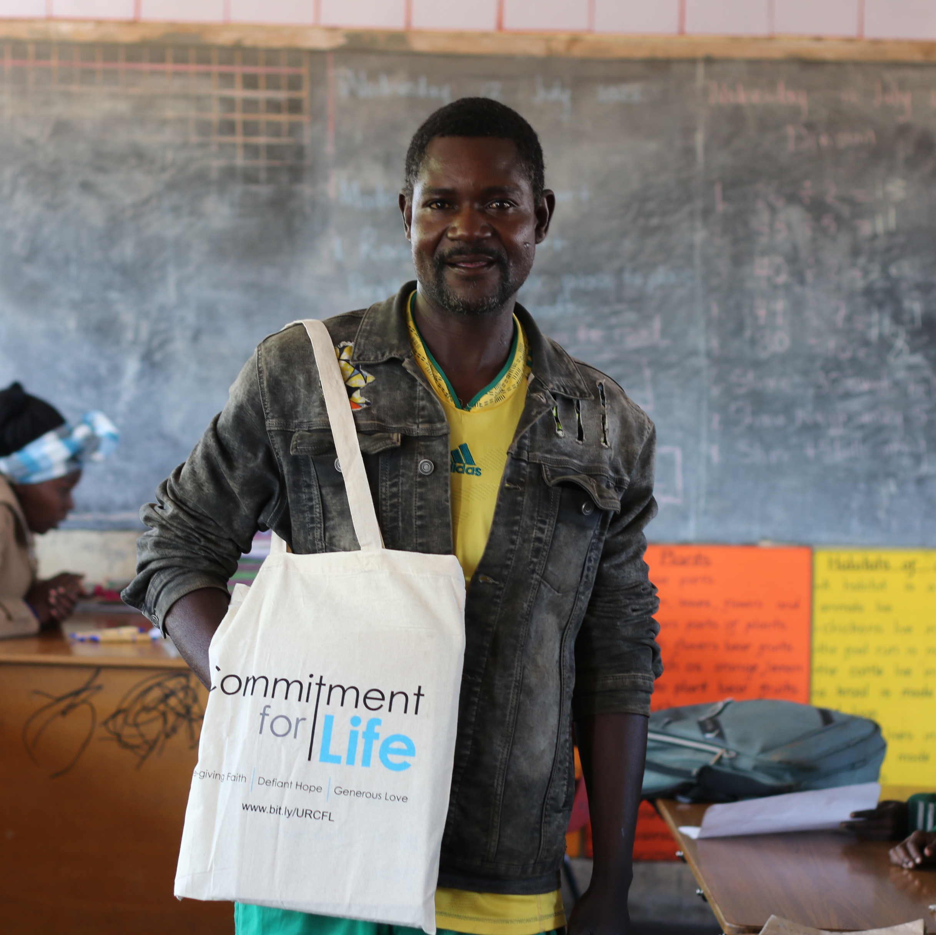
Harvest Service 2023
Love in action!
Notes:
NOTES ON PICTURES:
Above right – harvesting really tasty fresh corn the BRACT project in the Mutoko and Mudzi region of Mashonaland, Zimbabwe. The BRACT programme's full title is: Building Resilience through improving the Absorptive and Adaptive Capacity for Transformation (BRACT) of at risk communities. The project seeks to 1) improve capacity to anticipate, prepare and respond to shocks and stresses in order to maintain productive capacity. 2) Develop diversified, viable livelihood options adapted to climatic and socio-economic shocks and stresses. 3) Strengthen community voice and ability to engage service providers and enhance their participation in decision making.
Centre: this is a parent of a pupil at the Falcon Junior School in Harare, modelling a Commitment for Life tote bag for Kevin

Slide 2
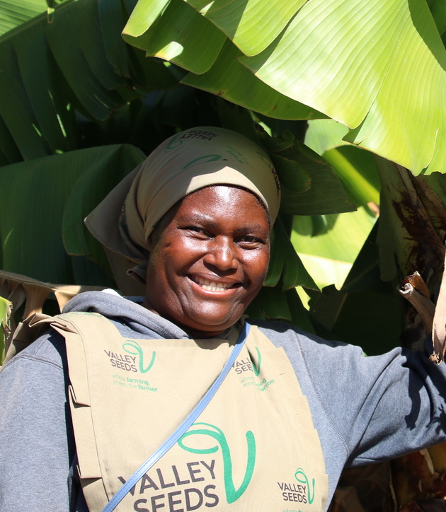
Welcome! Love in Action
Notes:
Gloria is one of the excellent farmers in Mutoko, standing next to a very healthy banana plant

Slide 3
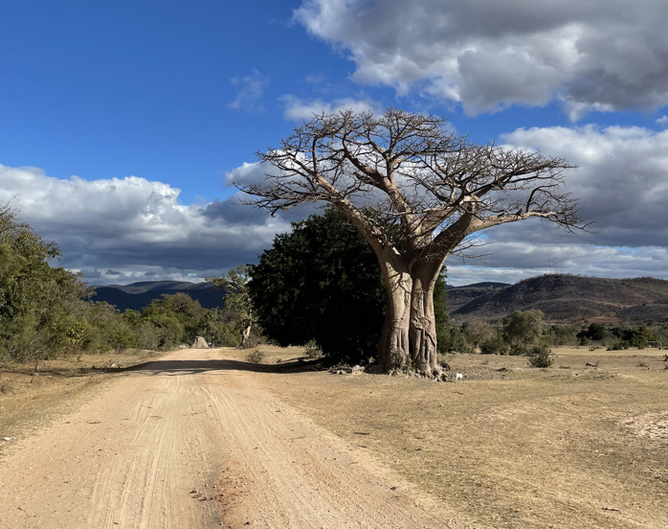
Call to Worship Isaiah 55 (various vss.)
Notes:
This magnificent Baobab tree is on the road that runs along the Mozambique border

Slide 4
Insert Hymn here

Slide 5

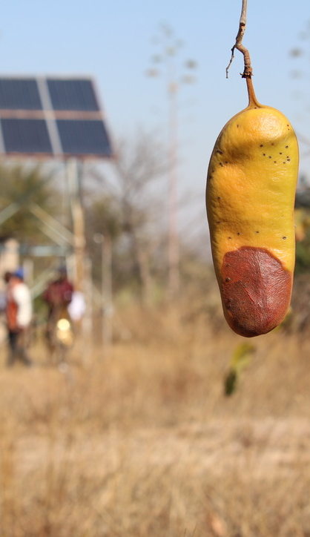
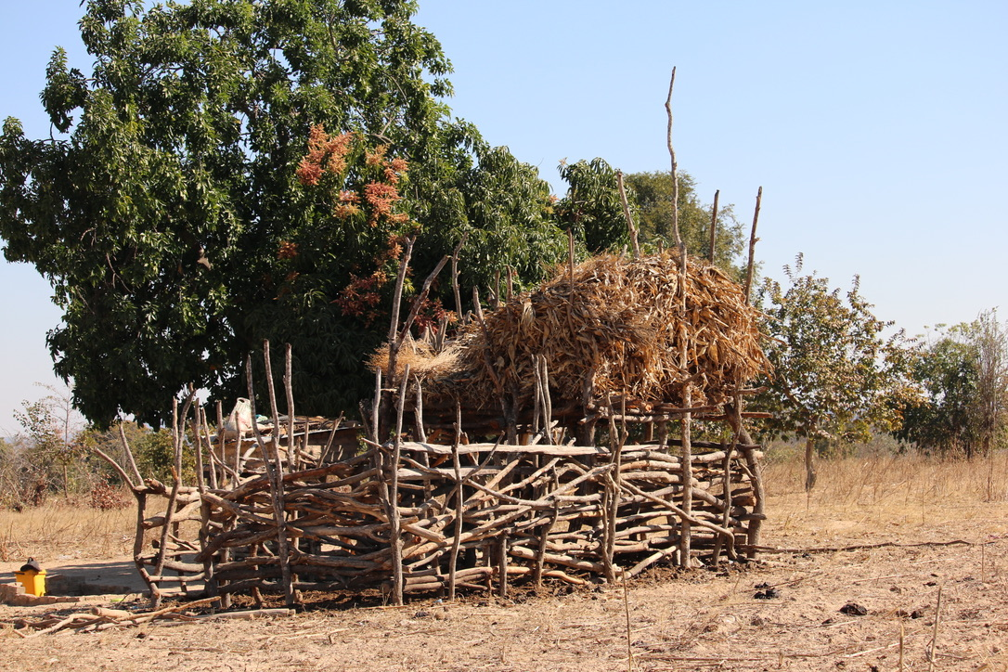
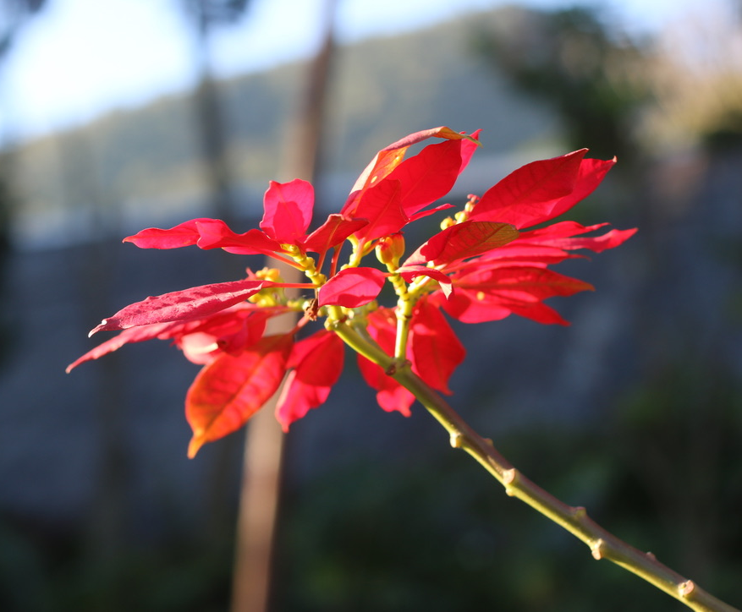
Opening Prayer
Notes:
Top Left: ancient technology that still works brilliantly to store grains away from cattle and goats.
Bottom Left: this lovely Poinsettia was growing in the hotel grounds just outside of Mutare (The Wise Owl Hotel)
Right: fruit of what I think is Philiostigma reticulatum in front of a solar powered borehole in the Buhera District near Marenga, servicing a Christian Aid supported clinic

Slide 6
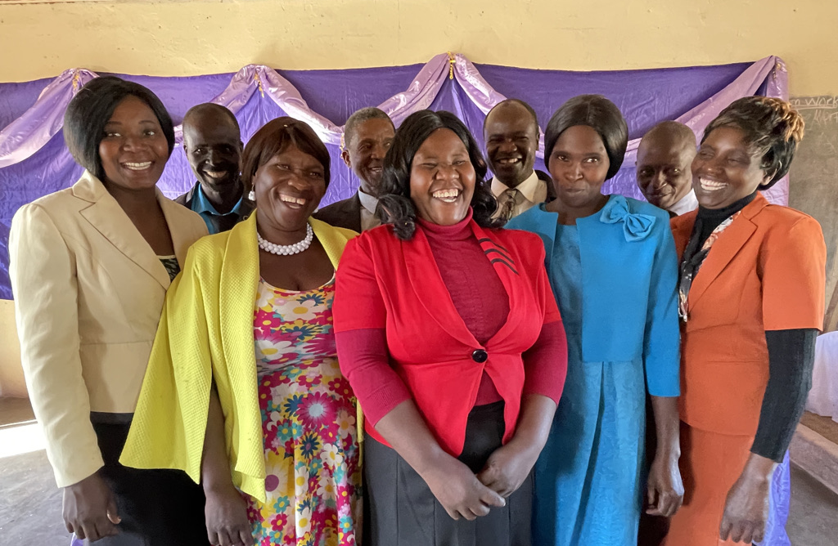
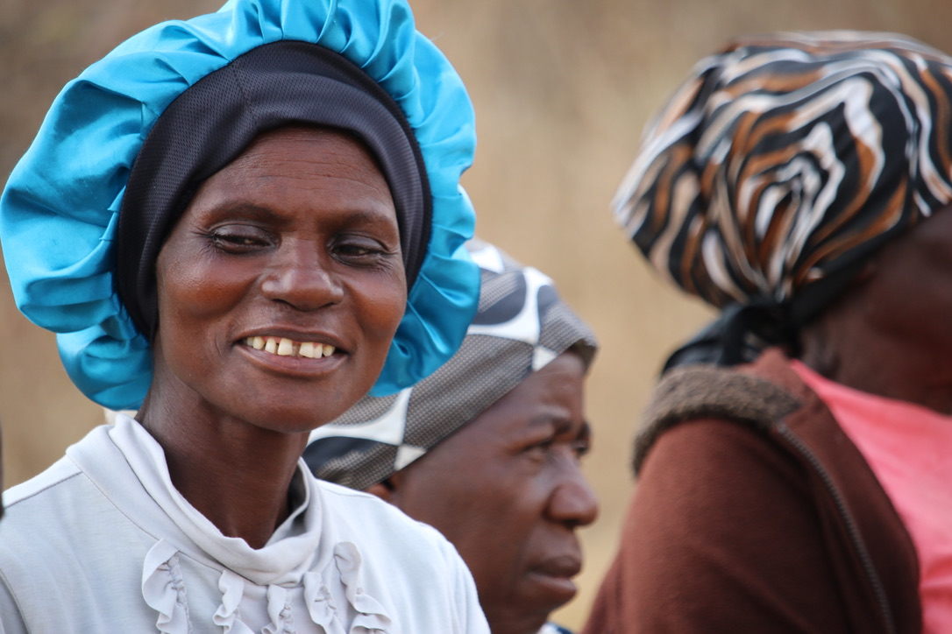
All Age Activity: Invitation to a Party!
Notes:
Left: teachers posing for a photo from a school in Mberengwa
Right: traditional singers in Great Zimbabwe

Slide 7
Insert Hymn here

Slide 8


What is Commitment for Life?

Slide 9
Love in Action Video
https://youtu.be/zx8Z5bEyHVE

Slide 10
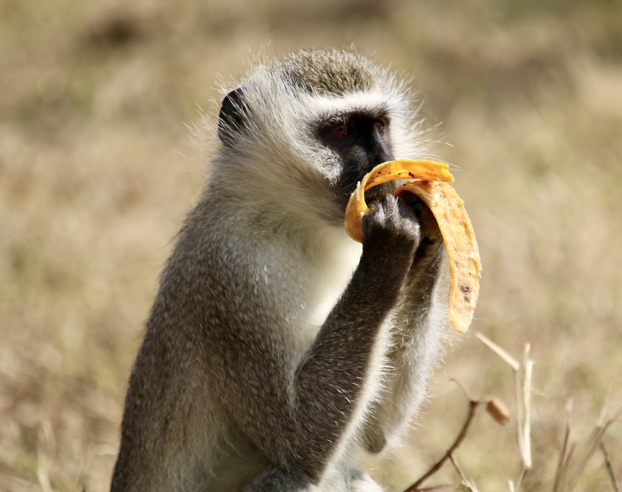
Sermon
Notes:
These little guys enjoying a banana at Great ZImbabwe

Slide 11
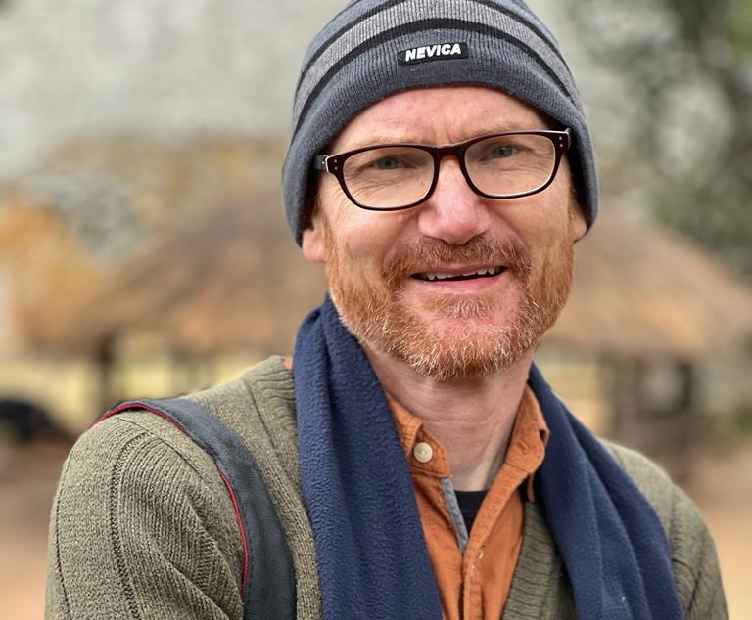
Notes:
What a handsome fella

Slide 12
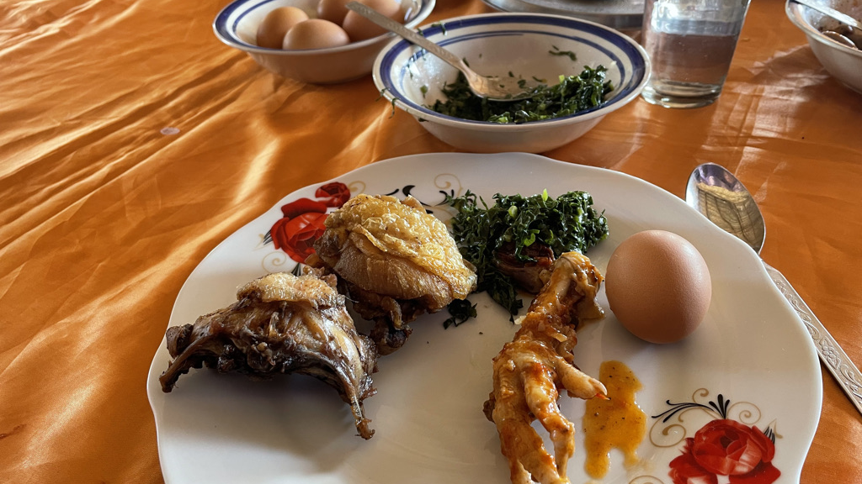
Notes:
Kevin being offered the very tastiest bits of the chicken at a meal hosted by a school in Mberengwa

Slide 13
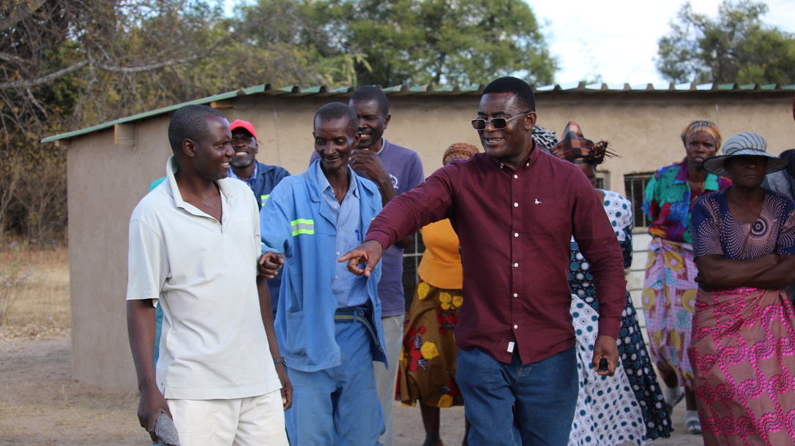
Notes:
Revd Wilbert Sayimani leading a question and answer session about how feed scourced from indigenous plants is collected, milled, and stored by local people here in Buhera District

Slide 14
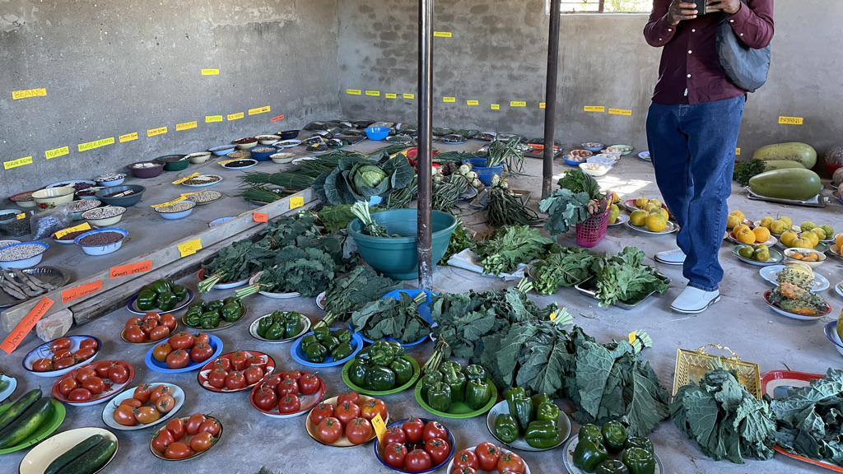
Notes:
We arrived on the day of a food production competition hosted by the Zimbabwe government. Just look at this produce!

Slide 15
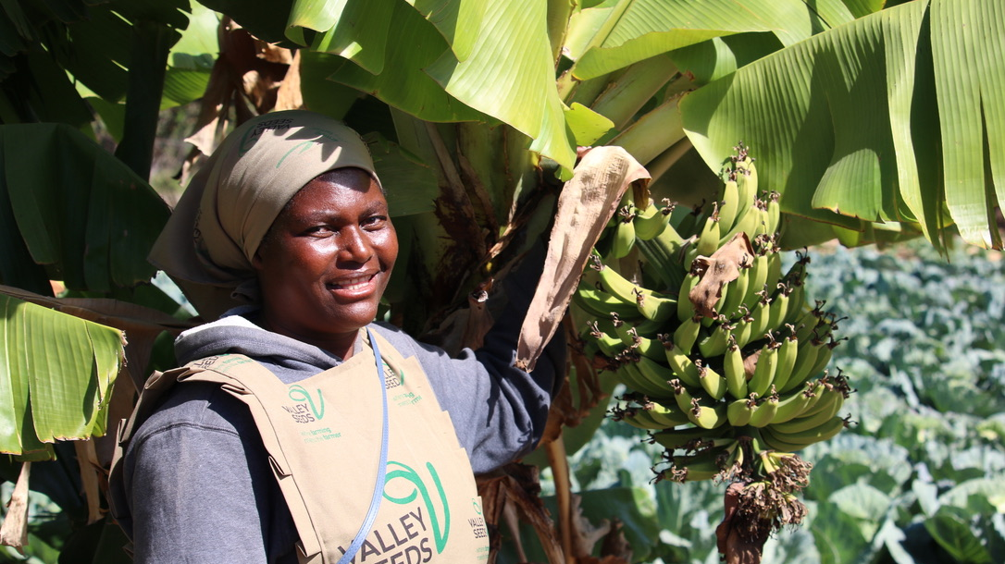
Notes:
Gloria proudly showing her bananas

Slide 16
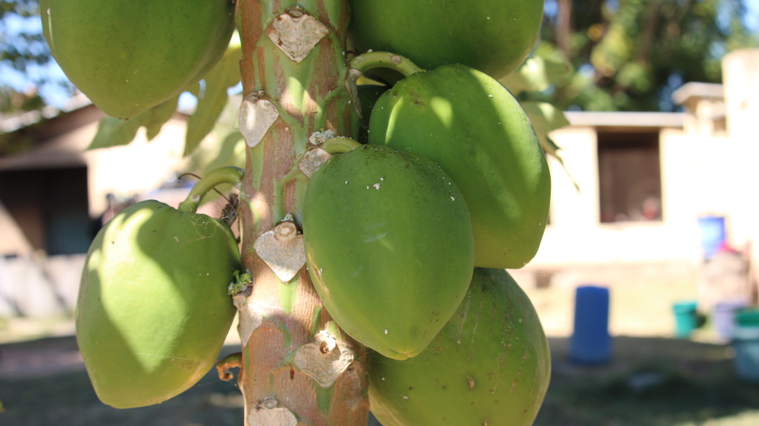
Notes:
Papaya grows with sheer abandon in Zimbabwe

Slide 17
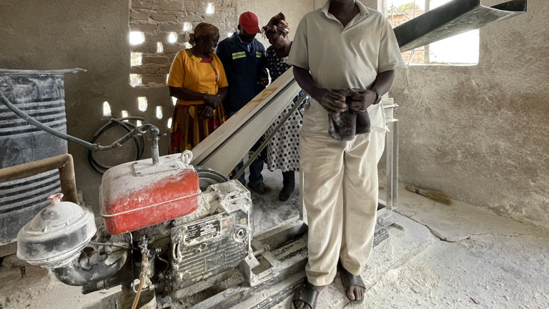
Notes:
This is a mill supplied by Christian Aid to this community in Buhera District. Local plants are carefully selected then milled in specific proportions, then used as a supplement to cattle and goat feed

Slide 18
Notes:
Love the old technology – this protects grains from cattle and goats

Slide 19
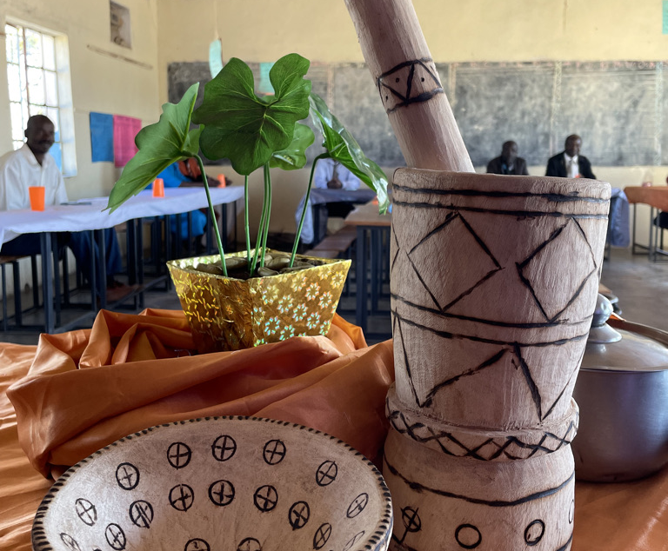
Notes:
Traditional way to pound grains into fine porridge

Slide 20
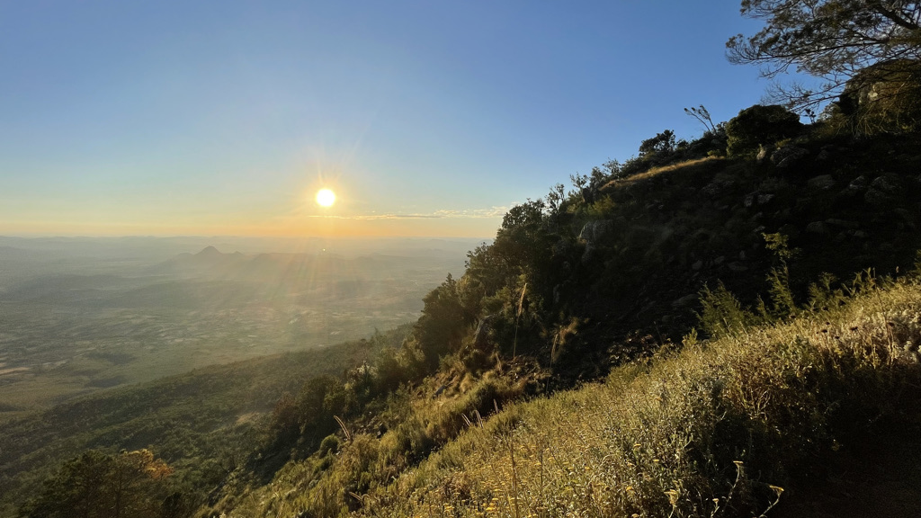
Notes:
Sunset over World’s View in Nyanga, Eastern Highlands

Slide 21
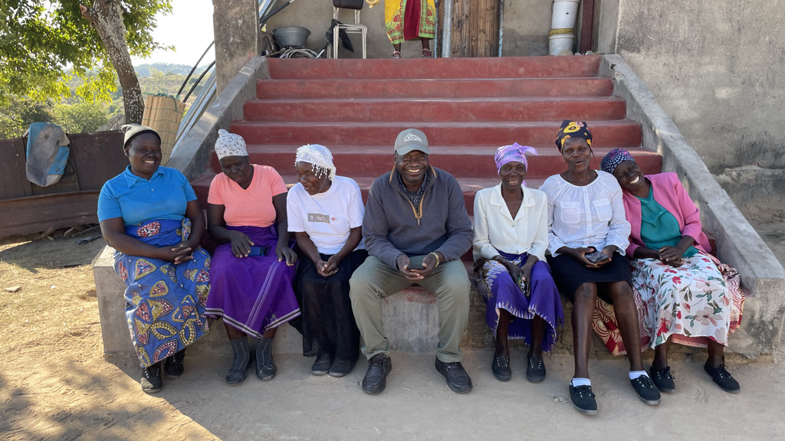
Notes:
Revd Naison Hove at his family home in Mberengwa.

Slide 22
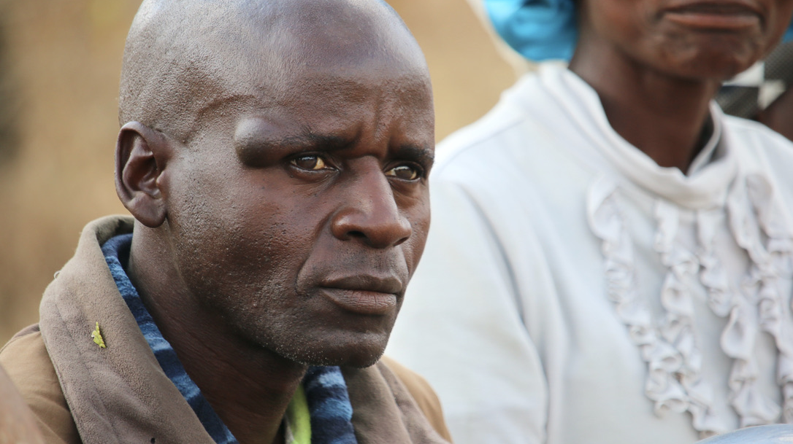
Notes:
This man plays the Mbira (Thumb Piano) incredibly well

Slide 23
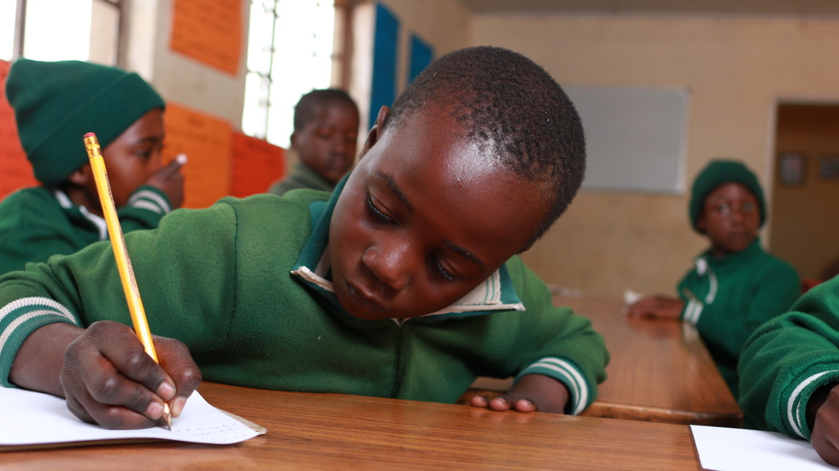
Notes:
Student takeing careful notes in classroom, Flacon Junior School hear Harare

Slide 24
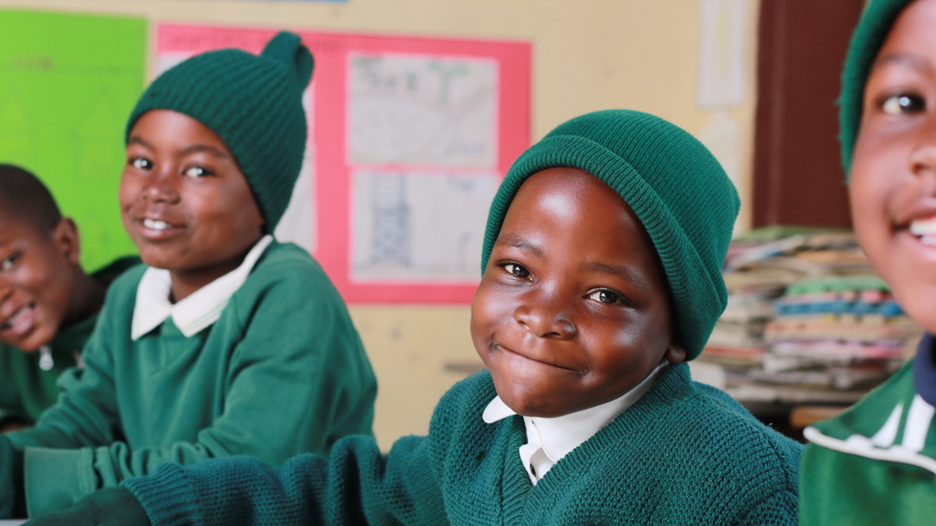
Notes:
Love that smile – learners at Falcon Junior School, Harare

Slide 25
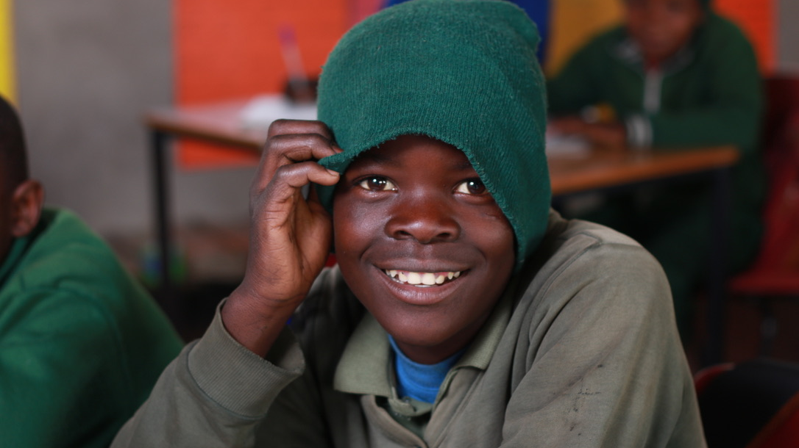
Notes:
Ah – got him to smile!

Slide 26
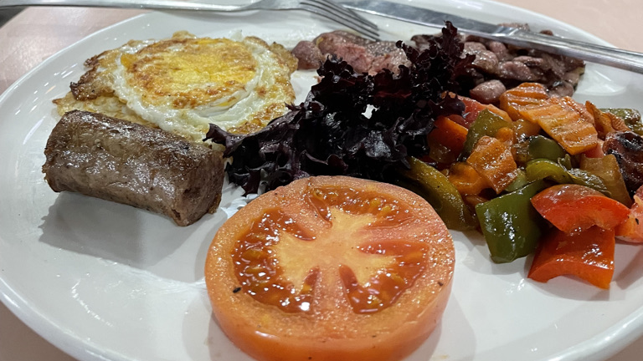
Notes:
Final meal before leaving home: boerewors, egg, tomato, bacon and fried veggie mix

Slide 27
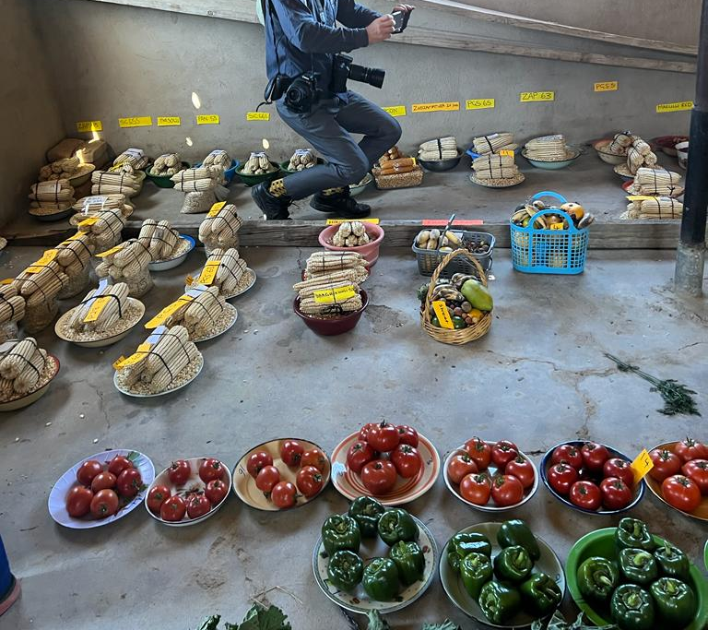
Offering

Slide 28

Questions in Groups
1) Have you ever travelled to an African country? Please share with two or three people around you
2) What are some of the ways that you already - or could - work to address poverty in the world?

Slide 29
Hymn here

Slide 30
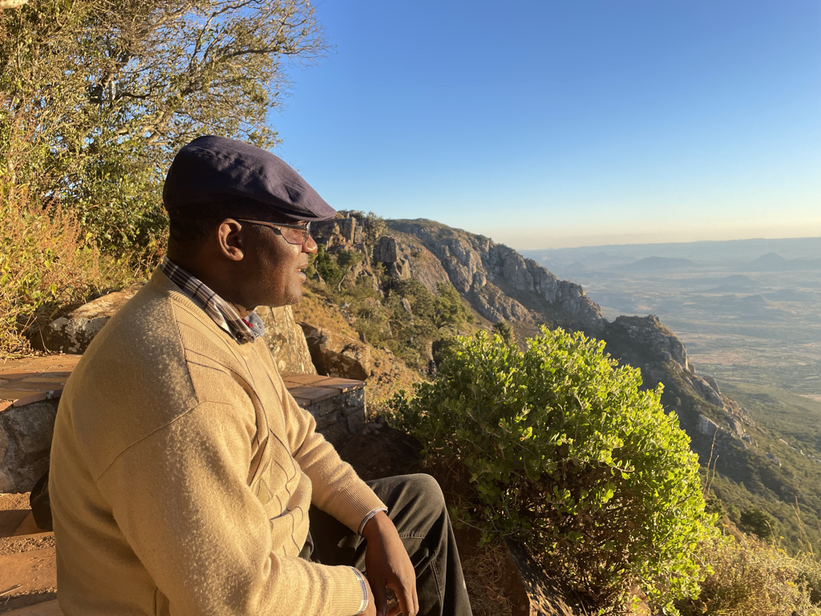
Prayers of Intercession
Notes:
Wilbert Sayiman taking a moment to contemplate God’s beauty in Nyanga, Eastern Highlands

Slide 31
Insert Final hymn here

Slide 32
Insert Benediction

